Slide 1
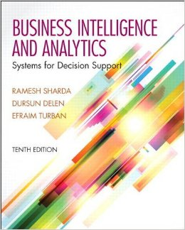
Business Intelligence and Analytics: Systems for Decision Support
(10th Edition)
Chapter 1:
An Overview of Business Intelligence, Analytics, and Decision Support

Slide 2
The Business Environment
The environment in which organizations operate today is becoming more and more complex, creating
  opportunities, and
  problems.
  Example: globalization.
Business environment factors:
  markets, consumer demands, technology, and societal…

Slide 3
Organizational Responses
Be Reactive, Anticipative, Adaptive, and Proactive
Managers may take actions, such as
  Employ strategic planning.
  Use new and innovative business models.
  Restructure business processes.
  Participate in business alliances.
  Improve corporate information systems.
  … more [in your book]

Slide 4
Managerial Decision Making
Management is a process by which organizational goals are achieved by using resources.
  Inputs: resources
  Output: attainment of goals
  Measure of success: outputs / inputs
Management ≅ Decision Making
Decision making: selecting the best solution from two or more alternatives

Slide 5
The Nature of Managers’ Work
Mintzberg's 10 Managerial Roles
Interpersonal
1. Figurehead
2. Leader
3. Liaison
Informational
4. Monitor
5. Disseminator
6. Spokesperson
Decisional
7. Entrepreneur
8. Disturbance handler
9. Resource allocator
10. Negotiator

Slide 6
Decision-Making Process
Managers usually make decisions by following a four-step process (a.k.a. the scientific approach)
  Define the problem (or opportunity)
  Construct a model that describes the real-world problem.
  Identify possible solutions to the modeled problem and evaluate the solutions.
  Compare, choose, and recommend a potential solution to the problem.

Slide 7
Information Systems Support for Decision Making
Group communication and collaboration
Improved data management
Managing data warehouses and Big Data
Analytical support
Overcoming cognitive limits in processing and storing information
Knowledge management
Anywhere, anytime support

Slide 8
An Early Decision Support Framework
Degree of Structuredness (Simon, 1977)
  Decisions are classified as
    Highly structured (a.k.a. programmed)
    Semi-structured
    Highly unstructured (i.e., nonprogrammed)
Types of Control (Anthony, 1965)
  Strategic planning (top-level, long-range)
  Management control (tactical planning)
  Operational control

Slide 9
The Concept of DSS
DSS - interactive computer-based systems, which help decision makers utilize data and models to solve unstructured problems
(Gorry and Scott-Morton, 1971)
Decision support systems couple the intellectual resources of individuals with the capabilities of the computer to improve the quality of decisions.
DS as an Umbrella Term
Evolution of DS into Business Intelligence

Slide 10
Definition of BI
BI is an umbrella term that combines architectures, tools, databases, analytical tools, applications, and methodologies
BI is a content-free expression, so it means different things to different people
BI's major objective is to enable easy access to data (and models) to provide business managers with the ability to conduct analysis
BI helps transform data, to information (and knowledge), to decisions, and finally to action

Slide 11
The Architecture of BI
A BI system has four major components
  a data warehouse, with its source data
  business analytics, a collection of tools for manipulating, mining, and analyzing the data in the data warehouse
  business performance management (BPM) for monitoring and analyzing performance
  a user interface (e.g., dashboard)

Slide 12
A High-Level Architecture of BI

Slide 13

Business Value of BI Analytical Applications
Customer segmentation
Propensity to buy
Customer profitability
Fraud detection
Customer attrition
Channel optimization

Slide 14
Analytics Overview
Analytics?
  Something new or just a new name for …
A Simple Taxonomy of Analytics (proposed by INFORMS)
  Descriptive Analytics
  Predictive Analytics
  Prescriptive Analytics
Analytics or Data Science?

Slide 15
Analytics Overview

Slide 16
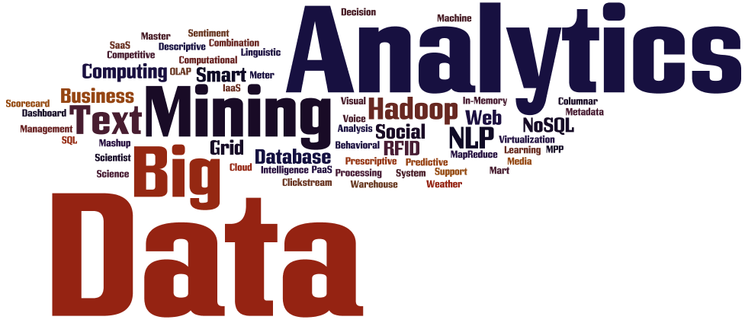
Introduction to Big Data Analytics
Big Data?
  Not just big!
  Volume
  Variety
  Velocity
More of Big Data and related analytics tools and techniques are covered in Chapter 13.

Slide 17
End of the Chapter
Questions / Comments…

Slide 18
Business Intelligence and Analytics: Systems for Decision Support
(10th Edition)
Chapter 2:
Foundations and Technologies
for Decision Making

Slide 19
Characteristics of Decision Making
Groupthink
Evaluating what-if scenarios
Experimentation with a real system!
Changes in the decision-making environment may occur continuously
Time pressure on the decision maker
Analyzing a problem takes time/money
Insufficient or too much information

Slide 20
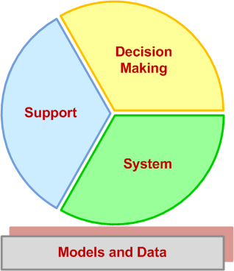
Characteristics of Decision Making
Decision Support Systems (DSS)
Dissecting DSS into its main concepts →
Building successful DSS requires a thorough understanding of these concepts

Slide 21
Decision Making
A process of choosing among two or more alternative courses of action for the purpose of attaining a goal(s)
Managerial decision making is synonymous with the entire management process - Simon (1977)
Example: Planning
  What should be done? When? Where? Why? How? By whom?

Slide 22
Decision-Making Disciplines
Behavioral: anthropology, law, philosophy, political science, psychology, social psychology, and sociology
Scientific: computer science, decision analysis, economics, engineering, the hard sciences (e.g., biology, chemistry, physics), management science/operations research, mathematics, and statistics
Each discipline has its own set of assumptions and each contributes a unique, valid view of how people make decisions

Slide 23
Decision-Making Disciplines
Better decisions
  Tradeoff: accuracy versus speed
Fast decision may be detrimental
Many areas suffer from fast decisions
Effectiveness versus Efficiency
Effectiveness → “goodness” “accuracy”
Efficiency → “speed” “less resources”
A fine balance is what is needed!

Slide 24
Decision Style
The manner by which decision makers think and react to problems
  perceive a problem
  cognitive response
  values and beliefs
When making decisions, people…
  follow different steps/sequence
  give different emphasis, time allotment, and priority to each step

Slide 25
Decision Style
Personality temperament tests are often used to determine decision styles
There are many such tests
  Meyers/Briggs,
  True Colors (Birkman),
  Keirsey Temperament Theory, …
Various tests measure somewhat different aspects of personality
  They cannot be equated!

Slide 26
Decision Style
Decision-making styles
  Heuristic versus Analytic
  Autocratic versus Democratic
  Consultative (with individuals or groups)
A successful computerized system should fit the decision style and the decision situation
  Should be flexible and adaptable to different users (individuals vs. groups)

Slide 27
Decision Makers
Small organizations
  Individuals
  Conflicting objectives
Medium-to-large organizations
  Groups
  Different styles, backgrounds, expectations
  Conflicting objectives
  Consensus is often difficult to reach
  Help: Computer support, GSS, …

Slide 28
Phases of
Decision-Making Process
Humans consciously or subconsciously follow a systematic decision-making process - Simon (1977)
  Intelligence
  Design
  Choice
  Implementation
  (?) Monitoring (a part of intelligence?)

Slide 29
Decision Making:
Intelligence Phase
Scan the environment, either intermittently or continuously
Identify problem situations or opportunities
Monitor the results of the implementation
Problem is the difference between what people desire (or expect) and what is actually occurring
  Symptom versus Problem
Timely identification of opportunities is as important as identification of problems

Slide 30
Decision Making:
Intelligence Phase
Potential issues in data/information collection and estimation
  Lack of data
  Cost of data collection
  Inaccurate and/or imprecise data
  Data estimation is often subjective
  Data may be insecure
  Key data may be qualitative
  Data change over time (time-dependence)

Slide 31
Decision Making:
Intelligence Phase
Problem Classification
  Classification of problems according to the degree of structuredness
Problem Decomposition
  Often solving the simpler subproblems may help in solving a complex problem.
  Information/data can improve the structuredness of a problem situation
Problem Ownership
Outcome of intelligence phase →
A Formal Problem
Statement

Slide 32
Decision Making:
The Design Phase
Finding/developing and analyzing possible courses of actions
A model of the decision-making problem is constructed, tested, and validated
Modeling: conceptualizing a problem and abstracting it into a quantitative and/or qualitative form (i.e., using symbols/variables)
  Abstraction: making assumptions for simplification
  Tradeoff (cost/benefit): more or less abstraction
  Modeling: both an art and a science

Slide 33
Decision Making:
The Design Phase
Selection of a Principle of Choice
  It is a criterion that describes the acceptability of a solution approach
  Reflection of decision-making objective(s)
  In a model, it is the result variable
  Choosing and validating against
    High-risk versus low-risk
    Optimize versus satisfice
  Criterion is not a constraint!
    See Technology Insight 2.1

Slide 34
Decision Making:
The Design Phase
Normative models (= optimization)
  the chosen alternative is demonstrably the best of all possible alternatives
  Assumptions of rational decision makers
    Humans are economic beings whose objective is to maximize the attainment of goals
    For a decision-making situation, all alternative courses of action and consequences are known
    Decision makers have an order or preference that enables them to rank the desirability of all consequences

Slide 35
Decision Making:
The Design Phase
Heuristic models (= suboptimization)
  The chosen alternative is the best of only a subset of possible alternatives
  Often, it is not feasible to optimize realistic (size/complexity) problems
  Suboptimization may also help relax unrealistic assumptions in models
  Help reach a good enough solution faster

Slide 36
Decision Making:
The Design Phase
Descriptive models
  Describe things as they are or as they are believed to be (mathematically based)
  They do not provide a solution but information that may lead to a solution
  Simulation - most common descriptive modeling method (mathematical depiction of systems in a computer environment)
  Allows experimentation with the descriptive model of a system

Slide 37
Decision Making:
The Design Phase
Developing (Generating) Alternatives
  In optimization models (such as linear programming), the alternatives may be generated automatically
  In most MSS situations, however, it is necessary to generate alternatives manually
  Use of GSS helps generate alternatives
Measuring/ranking the outcomes
  Using the principle of choice

Slide 38
Decision Making:
The Design Phase
Risk
  Lack of precise knowledge (uncertainty)
  Risk can be measured with probability
Scenario (what-if case)
  A statement of assumptions about the operating environment (variables) of a particular system at a given time
  Possible scenarios: best, worst, most likely, average (and custom intervals)

Slide 39
Decision Making:
The Choice Phase
The actual decision and the commitment to follow a certain course of action are made here
The boundary between the design and choice is often unclear (partially overlapping phases)
  Generate alternatives while performing evaluations
Includes the search, evaluation, and recommendation of an appropriate solution to the model
Solving the model versus solving the problem!

Slide 40
Decision Making:
The Choice Phase
Search approaches
  Analytic techniques (solving with a formula)
  Algorithms (step-by-step procedures)
  Heuristics (rule of thumb)
  Blind search (truly random search)
Additional activities
  Sensitivity analysis
  What-if analysis
  Goal seeking

Slide 41
Decision Making:
The Implementation Phase
“Nothing more difficult to carry out, nor more doubtful of success, nor more dangerous to handle, than to initiate a new order of things.”
- The Prince, Machiavelli 1500s
Solution to a problem → Change
Change management ?..
Implementation: putting a recommended solution to work

Slide 42
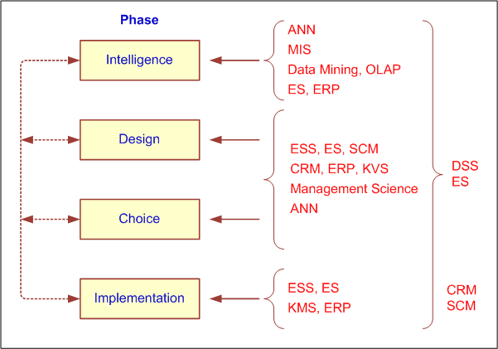
How Decisions are Supported

Slide 43
How Decisions are Supported
Support for the Intelligence Phase
  Enabling continuous scanning of external and internal information sources to identify problems and/or opportunities
  Resources/technologies: Web; ES, OLAP, data warehousing, data/text/Web mining, EIS/Dashboards, KMS, GSS, GIS,…
  Business activity monitoring (BAM)
  Business process management (BPM)
  Product life-cycle management (PLM)

Slide 44
How Decisions are Supported
Support for the Design Phase
  Enabling generating alternative courses of action, determining the criteria for choice
  Generating alternatives
    Structured/simple problems: standard and/or special models
    Unstructured/complex problems: human experts, ES, KMS, brainstorming/GSS, OLAP, data/text mining
A good “criteria for choice” is critical!

Slide 45
How Decisions are Supported
Support for the Choice Phase
  Enabling selection of the best alternative given a complex constraint structure
  Use sensitivity analyses, what-if analyses, goal seeking
  Resources
    KMS
    CRM, ERP, and SCM
    Simulation and other descriptive models

Slide 46
How Decisions are Supported
Support for the Implementation Phase
  Enabling implementation/deployment of the selected solution to the system
  Decision communication, explanation and justification to reduce resistance to change
  Resources
    Corporate portals, Web 2.0/Wikis
    Brainstorming/GSS
    KMS, ES

Slide 47
DSS Capabilities
DSS early definition: it is a system intended to support managerial decisions in semistructured and unstructured decision situations
DSS were meant to be adjuncts to decision makers → extending their capabilities
They are computer based and would operate interactively online, and preferably would have graphical output capabilities
Nowadays, simplified via Web browsers and mobile devices

Slide 48
DSS Classifications
AIS SIGDSS Classification
  Communication-driven and group DSS
  Data-driven DSS
  Document-driven DSS
  Knowledge-driven DSS
  Model-driven DSS
Often DSS is a hybrid of many classes

Slide 49
DSS Classifications
Other DSS Categories
  Institutional and ad-hoc DSS
  Custom-made systems versus ready-made systems
  Personal, group, and organizational support
  Individual support system versus group support system (GSS)…

Slide 50
Components of DSS
Data Management Subsystem
  Includes the database that contains the data
  Database management system (DBMS)
  Can be connected to a data warehouse
Model Management Subsystem
  Model base management system (MBMS)
User Interface Subsystem
Knowledgebase Management Subsystem
  Organizational knowledge base

Slide 51
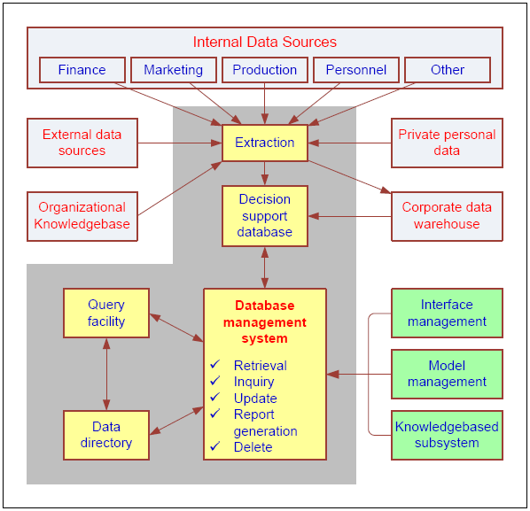
DSS Components:
Data Management Subsystem
DSS database
DBMS
Data directory
Query facility

Slide 52
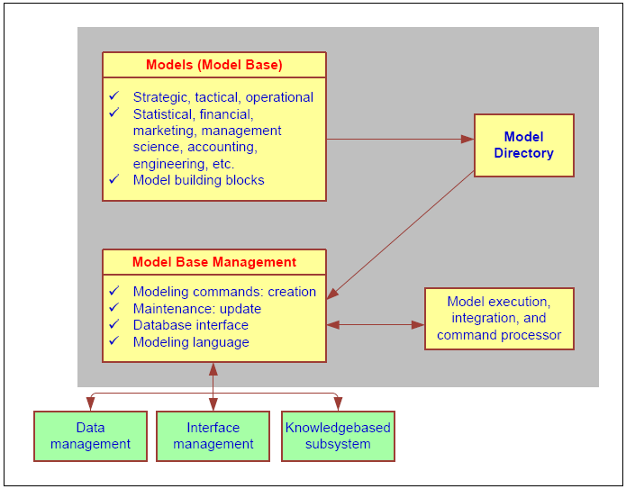
DSS Components:
Model Management Subsystem
Model base
MBMS
Modeling language
Model directory
Model execution, integration, and command processor

Slide 53
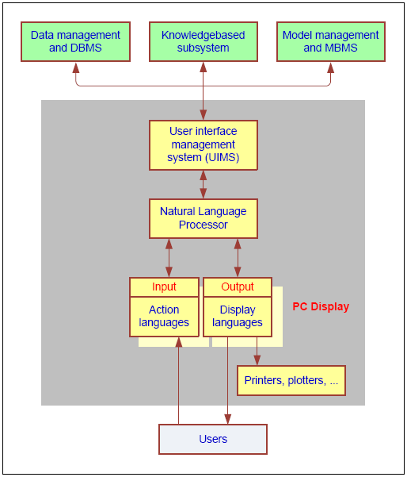
DSS Components:
User Interface Subsystem
Interface
  Application interface
  User Interface (GUI?)
DSS User Interface
  Portal
  Graphical icons
    Dashboard
  Color coding
Interfacing with PDAs, cell phones, etc.
  See Technology Insight 2.2 for next gen devices

Slide 54
End of the Chapter
Questions, comments

Slide 55
Business Intelligence and Analytics: Systems for Decision Support
(10th Edition)
Chapter 3:
Data Warehousing

Slide 56
What is a Data Warehouse?
A physical repository where relational data are specially organized to provide enterprise-wide, cleansed data in a standardized format
“The data warehouse is a collection of integrated, subject-oriented databases designed to support DSS functions, where each unit of data is non-volatile and relevant to some moment in time”

Slide 57
Characteristics of DWs
Subject oriented
Integrated
Time-variant (time series)
Nonvolatile
Summarized
Not normalized
Metadata
Web based, relational/multi-dimensional
Client/server, real-time/right-time/active...

Slide 58
Data Mart
A departmental small-scale “DW” that stores only limited/relevant data
  Dependent data mart
  A subset that is created directly from a data warehouse
  Independent data mart
  A small data warehouse designed for a strategic business unit or a department

Slide 59
A Generic DW Framework

Slide 60
DW Architecture
Three-tier architecture
  Data acquisition software (back-end)
  The data warehouse that contains the data & software
  Client (front-end) software that allows users to access and analyze data from the warehouse
Two-tier architecture
  First two tiers in three-tier architecture is combined into one
… sometimes there is only one tier?

Slide 61
DW Architectures
3-tier
architecture
2-tier
architecture
1-tier
Architecture
?

Slide 62
Data Warehousing Architectures
Issues to consider when deciding which architecture to use:
  Which database management system (DBMS) should be used?
  Will parallel processing and/or partitioning be used?
  Will data migration tools be used to load the data warehouse?
  What tools will be used to support data retrieval and analysis?

Slide 63
A Web-Based DW Architecture

Slide 64
Ten factors that potentially affect the architecture selection decision
Information interdependence between organizational units
Upper management’s information needs
Urgency of need for a data warehouse
Nature of end-user tasks
Constraints on resources
Strategic view of the data warehouse prior to implementation
Compatibility with existing systems
Perceived ability of the in-house IT staff
Technical issues
Social/political factors

Slide 65
Data Integration and the Extraction, Transformation, and Load Process
ETL = Extract Transform Load
Data integration
Integration that comprises three major processes: data access, data federation, and change capture.
Enterprise application integration (EAI)
A technology that provides a vehicle for pushing data from source systems into a data warehouse
Enterprise information integration (EII)
An evolving tool space that promises real-time data integration from a variety of sources, such as relational or multidimensional databases, Web services, etc.

Slide 66
Data Integration and the Extraction, Transformation, and Load Process

Slide 67
ETL (Extract, Transform, Load)
Issues affecting the purchase of an ETL tool
  Data transformation tools are expensive
  Data transformation tools may have a long learning curve
Important criteria in selecting an ETL tool
  Ability to read from and write to an unlimited number of data sources/architectures
  Automatic capturing and delivery of metadata
  A history of conforming to open standards
  An easy-to-use interface for the developer and the functional user

Slide 68
Additional DW Considerations Hosted Data Warehouses
Benefits:
  Requires minimal investment in infrastructure
  Frees up capacity on in-house systems
  Frees up cash flow
  Makes powerful solutions affordable
  Enables solutions that provide for growth
  Offers better quality equipment and software
  Provides faster connections
  … more in the book

Slide 69
Representation of Data in DW
Dimensional Modeling
  A retrieval-based system that supports high-volume query access
Star schema
  The most commonly used and the simplest style of dimensional modeling
  Contain a fact table surrounded by and connected to several dimension tables
Snowflakes schema
  An extension of star schema where the diagram resembles a snowflake in shape

Slide 70
Multidimensionality
The ability to organize, present, and analyze data by several dimensions, such as sales by region, by product, by salesperson, and by time (four dimensions)
Multidimensional presentation
  Dimensions: products, salespeople, market segments, business units, geographical locations, distribution channels, country, or industry
  Measures: money, sales volume, head count, inventory profit, actual versus forecast
  Time: daily, weekly, monthly, quarterly, or yearly

Slide 71
Star versus Snowflake Schema

Slide 72
Analysis of Data in DW
OLTP vs. OLAP…
OLTP (online transaction processing)
  Capturing and storing data from ERP, CRM, POS, …
  The main focus is on efficiency of routine tasks
OLAP (Online analytical processing)
  Converting data into information for decision support
  Data cubes, drill-down / rollup, slice & dice, …
  Requesting ad hoc reports
  Conducting statistical and other analyses
  Developing multimedia-based applications
  …more in the book

Slide 73
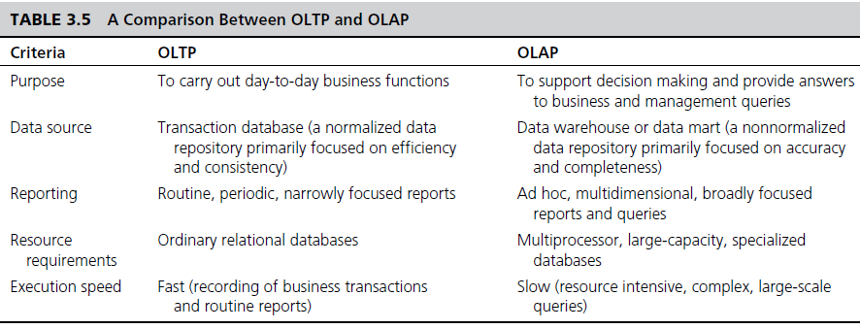
OLAP vs. OLTP

Slide 74
OLAP Operations
Slice - a subset of a multidimensional array
Dice - a slice on more than two dimensions
Drill Down/Up - navigating among levels of data ranging from the most summarized (up) to the most detailed (down)
Roll Up - computing all of the data relationships for one or more dimensions
Pivot - used to change the dimensional orientation of a report or an ad hoc query-page display

Slide 75
Variations of OLAP
Multidimensional OLAP (MOLAP)
OLAP implemented via a specialized multidimensional database (or data store) that summarizes transactions into multidimensional views ahead of time
Relational OLAP (ROLAP)
The implementation of an OLAP database on top of an existing relational database
Database OLAP and Web OLAP (DOLAP and WOLAP); Desktop OLAP,…

Slide 76
DW Implementation Issues
Identification of data sources and governance
Data quality planning, data model design
ETL tool selection
Establishment of service-level agreements
Data transport, data conversion
Reconciliation process
End-user support
Political issues
… more in the book

Slide 77
Failure Factors in DW Projects
Lack of executive sponsorship
Unclear business objectives
Cultural issues being ignored
  Change management
Unrealistic expectations
Inappropriate architecture
Low data quality / missing information
Loading data just because it is available

Slide 78
Massive DW and Scalability
Scalability
  The main issues pertaining to scalability:
    The amount of data in the warehouse
    How quickly the warehouse is expected to grow
    The number of concurrent users
    The complexity of user queries
  Good scalability means that queries and other data-access functions will grow linearly with the size of the warehouse

Slide 79
Real-Time/Active DW/BI
Enabling real-time data updates for real-time analysis and real-time decision making is growing rapidly
  Push vs. Pull (of data)
Concerns about real-time BI
  Not all data should be updated continuously
  Mismatch of reports generated minutes apart
  May be cost prohibitive
  May also be infeasible

Slide 80
DW Administration and Security
Data warehouse administrator (DWA)
  DWA should…
    have the knowledge of high-performance software, hardware and networking technologies
    possess solid business knowledge and insight
    be familiar with the decision-making processes so as to suitably design/maintain the data warehouse structure
    possess excellent communications skills
Security and privacy is a pressing issue in DW
  Safeguarding the most valuable assets
  Government regulations (HIPAA, etc.)
  Must be explicitly planned and executed

Slide 81
End of the Chapter
Questions, comments

Slide 82
Business Intelligence and Analytics: Systems for Decision Support
(10th Edition)
Chapter 4:
Business Reporting,
Visual Analytics, and Business
Performance Management

Slide 83
Business Reporting
Definitions and Concepts
Report = Information → Decision
Report?
  Any communication artifact prepared to convey specific information
A report can fulfill many functions
  To ensure proper departmental functioning
  To provide information
  To provide the results of an analysis
  To persuade others to act
  To create an organizational memory…

Slide 84
What is a Business Report?
A written document that contains information regarding business matters.
Purpose: to improve managerial decisions
Source: data from inside and outside the organization (via the use of ETL)
Format: text + tables + graphs/charts
Distribution: in-print, email, portal/intranet
Data acquisition → Information generation → Decision making → Process management

Slide 85
Key to Any Successful Report
Clarity …
Brevity …
Completeness …
Correctness …
Report types (in terms of content and format)
  Informal – a single letter or a memo
  Formal – 10-100 pages; cover + summary + text
  Short report – periodic, informative, investigative

Slide 86
Types of Business Reports
Metric Management Reports
  Help manage business performance through metrics (SLAs for externals; KPIs for internals)
  Can be used as part of Six Sigma and/or TQM
Dashboard-Type Reports
  Graphical presentation of several performance indicators in a single page using dials/gauges
Balanced Scorecard-Type Reports
  Include financial, customer, business process, and learning & growth indicators

Slide 87
Data and Information Visualization
  “The use of visual representations to explore, make sense of, and communicate data.”
Data visualization vs. Information visualization
Information = aggregation, summarization, and contextualization of data
Related to information graphics, scientific visualization, and statistical graphics
Often includes charts, graphs, illustrations, …

Slide 88
Different Types of
Charts and Graphs
Which one to use? Where and when?
Basic Charts and Graphs
  Line Chart
  Bar Chart
  Pie Chart
  Scatter Plot
  Bubble Chart
Specialized Charts and Graphs
  Histogram
  Gantt Chart
  PERT Chart
  Geographic Map
  Bullet Graph
  Heat Map / Tree Map
  Highlight Table

Slide 89
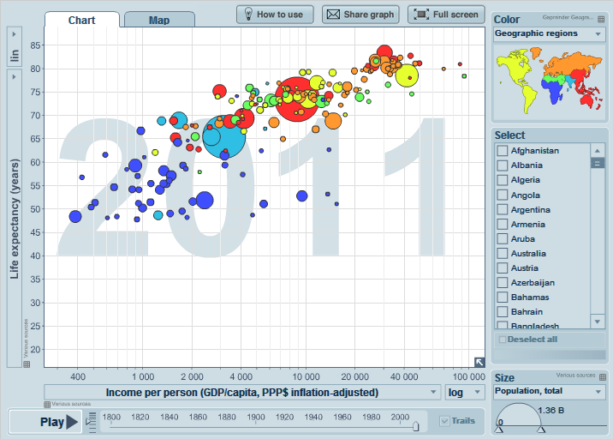
A Gapminder Chart
Wealth and Health of Nations
See gapminder.org for
interesting animated examples

Slide 90
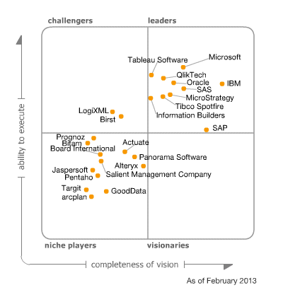
The Emergence of Data Visualization And Visual Analytics
Magic Quadrant for Business Intelligence and Analytics Platforms (Source: Gartner.com)
Many data visualization companies are in the 4th quadrant
There is a move toward visualization

Slide 91
Visual Analytics
A recently coined term
  Information visualization + predictive analytics
Information visualization
  Descriptive, backward focused
  “what happened” “what is happening”
Predictive analytics
  Predictive, future focused
  “what will happen” “why will it happen”
There is a strong move toward visual analytics

Slide 92
Performance Dashboards
Performance dashboards are commonly used in BPM software suites and BI platforms
Dashboards provide visual displays of important information that is consolidated and arranged on a single screen so that information can be digested at a single glance and easily drilled in and further explored

Slide 93
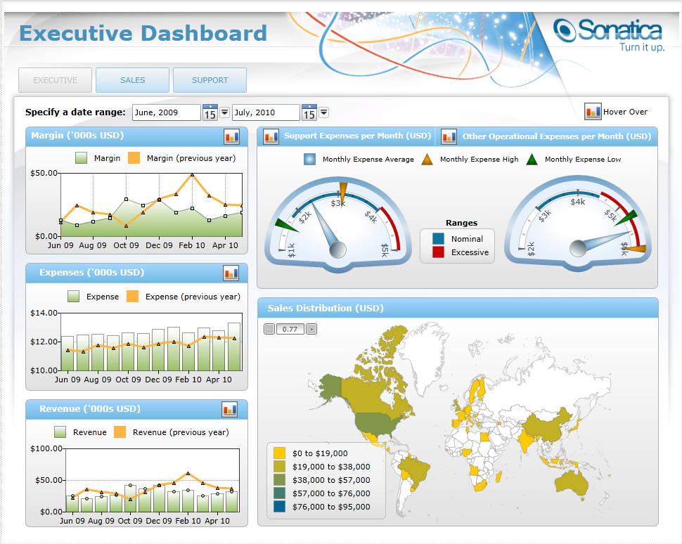
Performance Dashboards

Slide 94
Performance Dashboards
Dashboard design
  The fundamental challenge of dashboard design is to display all the required information on a single screen, clearly and without distraction, in a manner that can be assimilated quickly
Three layer of information
  Monitoring
  Analysis
  Management

Slide 95
Best Practices in
Dashboard Design
Benchmark KPIs with Industry Standards
Wrap the Metrics with Contextual Metadata
Validate the Design by a Usability Specialist
Prioritize and Rank Alerts and Exceptions
Enrich Dashboard with Business-User Comments
Present Information in Three Different Levels
Pick the Right Visual Constructs
Provide for Guided Analytics

Slide 96
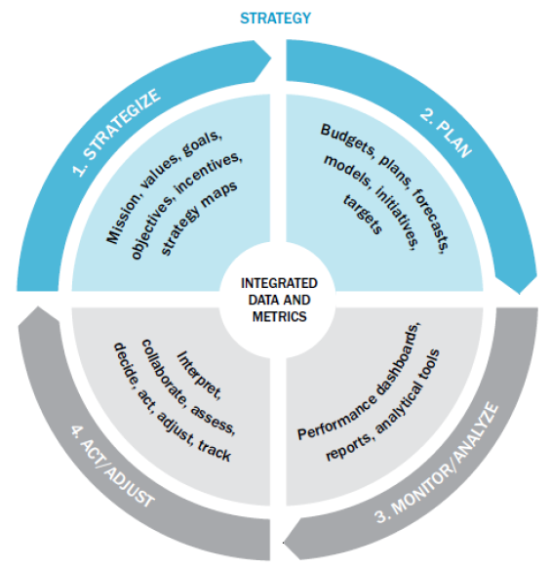
A Closed-Loop Process to Optimize Business Performance
Process Steps
  Strategize
  Plan
  Monitor/analyze
  Act/adjust
  Each with its own process steps

Slide 97
End of the Chapter
Questions, comments

Slide 98
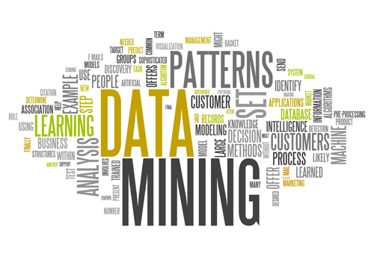
Business Intelligence and Analytics: Systems for Decision Support
(10th Edition)
Chapter 5:
Data Mining

Slide 99
Definition of Data Mining
The nontrivial process of identifying valid, novel, potentially useful, and ultimately understandable patterns in data stored in structured databases. - Fayyad et al., (1996)
Keywords in this definition: Process, nontrivial, valid, novel, potentially useful, understandable.
Data mining: a misnomer?
Other names: knowledge extraction, pattern analysis, knowledge discovery, information harvesting, pattern searching, data dredging,…

Slide 100
Data Mining is at the Intersection of Many Disciplines

Slide 101
Data Mining Characteristics/Objectives
Source of data for DM is often a consolidated data warehouse (not always!).
DM environment is usually a client-server or a Web-based information systems architecture.
Data is the most critical ingredient for DM which may include soft/unstructured data.
The miner is often an end user
Striking it rich requires creative thinking
Data mining tools’ capabilities and ease of use are essential (Web, Parallel processing, etc.)

Slide 102
Data in Data Mining
Data: a collection of facts usually obtained as the result of experiences, observations, or experiments.
Data may consist of numbers, words, images, …
Data: lowest level of abstraction (from which information and knowledge are derived).

Slide 103
What Does DM Do?
How Does it Work?
DM extract patterns from data
  Pattern? A mathematical (numeric and/or symbolic) relationship among data items
Types of patterns
  Association
  Prediction
  Cluster (segmentation)
  Sequential (or time series) relationships

Slide 104
A Taxonomy for
Data Mining Tasks

Slide 105
Data Mining Tasks (cont.)
Time-series forecasting
  Part of sequence or link analysis?
Visualization
  Another data mining task?
Types of DM
  Hypothesis-driven data mining
  Discovery-driven data mining

Slide 106
Data Mining Applications
Customer Relationship Management
  Maximize return on marketing campaigns
  Improve customer retention (churn analysis)
  Maximize customer value (cross-, up-selling)
  Identify and treat most valued customers
Banking & Other Financial
  Automate the loan application process
  Detecting fraudulent transactions
  Maximize customer value (cross-, up-selling)
  Optimizing cash reserves with forecasting

Slide 107
Data Mining Applications (cont.)
Retailing and Logistics
  Optimize inventory levels at different locations
  Improve the store layout and sales promotions
  Optimize logistics by predicting seasonal effects
  Minimize losses due to limited shelf life
Manufacturing and Maintenance
  Predict/prevent machinery failures
  Identify anomalies in production systems to optimize the use manufacturing capacity
  Discover novel patterns to improve product quality

Slide 108
Data Mining Applications (cont.)
Brokerage and Securities Trading
  Predict changes on certain bond prices
  Forecast the direction of stock fluctuations
  Assess the effect of events on market movements
  Identify and prevent fraudulent activities in trading
Insurance
  Forecast claim costs for better business planning
  Determine optimal rate plans
  Optimize marketing to specific customers
  Identify and prevent fraudulent claim activities

Slide 109
Data Mining Process: CRISP-DM
Step 1: Business Understanding
Step 2: Data Understanding
Step 3: Data Preparation (!)
Step 4: Model Building
Step 5: Testing and Evaluation
Step 6: Deployment
The process is highly repetitive and experimental (DM: art versus science?)
Accounts for ~85% of total project time

Slide 110
Data Preparation – A Critical DM Task

Slide 111
Data Mining Process: SEMMA

Slide 112
Data Mining Methods: Classification
Most frequently used DM method
Part of the machine-learning family
Employ supervised learning
Learn from past data, classify new data
The output variable is categorical (nominal or ordinal) in nature
Classification versus regression?
Classification versus clustering?

Slide 113
Assessment Methods for Classification
Predictive accuracy
  Hit rate
Speed
  Model building; predicting
Robustness
Scalability
Interpretability
  Transparency, explainability

Slide 114
Accuracy of Classification Models
In classification problems, the primary source for accuracy estimation is the confusion matrix

Slide 115
Estimation Methodologies for Classification
Simple split (or holdout or test sample estimation)
  Split the data into 2 mutually exclusive sets training (~70%) and testing (30%)
  For ANN, the data is split into three sub-sets (training [~60%], validation [~20%], testing [~20%])

Slide 116
Estimation Methodologies for Classification
k-Fold Cross Validation (rotation estimation)
  Split the data into k mutually exclusive subsets
  Use each subset as testing while using the rest of the subsets as training
  Repeat the experimentation for k times
  Aggregate the test results for true estimation of prediction accuracy training
Other estimation methodologies
  Leave-one-out, bootstrapping, jackknifing
  Area under the ROC curve

Slide 117
Estimation Methodologies for Classification – ROC Curve

Slide 118
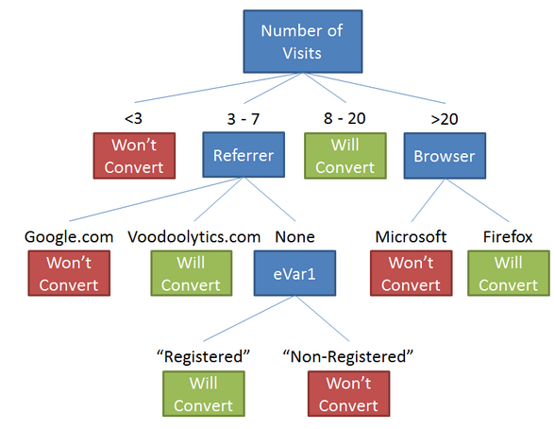
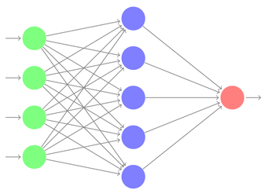
Classification Techniques
Decision tree analysis
Statistical analysis
Neural networks
Support vector machines
Case-based reasoning
Bayesian classifiers
Genetic algorithms
Rough sets

Slide 119
Cluster Analysis for Data Mining
Used for automatic identification of natural groupings of things
Part of the machine-learning family
Employ unsupervised learning
Learns the clusters of things from past data, then assigns new instances
There is not an output variable
Also known as segmentation

Slide 120
Cluster Analysis for Data Mining
Clustering results may be used to
  Identify natural groupings of customers
  Identify rules for assigning new cases to classes for targeting/diagnostic purposes
  Provide characterization, definition, labeling of populations
  Decrease the size and complexity of problems for other data mining methods
  Identify outliers in a specific domain (e.g., rare-event detection)

Slide 121
Cluster Analysis for Data Mining
Analysis methods
  Statistical methods (including both hierarchical and nonhierarchical), such as k-means, k-modes, and so on.
  Neural networks (adaptive resonance theory [ART], self-organizing map [SOM])
  Fuzzy logic (e.g., fuzzy c-means algorithm)
  Genetic algorithms

Slide 122
Cluster Analysis for Data Mining
How many clusters?
  There is not a “truly optimal” way to calculate it
  Heuristics are often used
Most cluster analysis methods involve the use of a distance measure to calculate the closeness between pairs of items.
  Euclidian versus Manhattan/Rectilinear distance

Slide 123
Association Rule Mining
A very popular DM method in business
Finds interesting relationships (affinities) between variables (items or events)
Part of machine learning family
Employs unsupervised learning
There is no output variable
Also known as market basket analysis
Often used as an example to describe DM to ordinary people, such as the famous “relationship between diapers and beers!”

Slide 124
Association Rule Mining
Input: the simple point-of-sale transaction data
Output: Most frequent affinities among items
Example: according to the transaction data…
“Customer who bought a lap-top computer and a virus protection software, also bought extended service plan 70 percent of the time."
How do you use such a pattern/knowledge?
  Put the items next to each other
  Promote the items as a package
  Place items far apart from each other!

Slide 125
Association Rule Mining
A representative applications of association rule mining include
  In business: cross-marketing, cross-selling, store design, catalog design, e-commerce site design, optimization of online advertising, product pricing, and sales/promotion configuration
  In medicine: relationships between symptoms and illnesses; diagnosis and patient characteristics and treatments (to be used in medical DSS); and genes and their functions (to be used in genomics projects)
  …

Slide 126
Association Rule Mining
Are all association rules interesting and useful?
  A Generic Rule: X ⇒ Y [S%, C%]
  X, Y: products and/or services
  X: Left-hand-side (LHS)
  Y: Right-hand-side (RHS)
  S: Support: how often X and Y go together
  C: Confidence: how often Y go together with the X
  Example: {Laptop Computer, Antivirus Software} ⇒ {Extended Service Plan} [30%, 70%]

Slide 127
Association Rule Mining
Algorithms are available for generating association rules
  Apriori
  Eclat
  FP-Growth
  + Derivatives and hybrids of the three
The algorithms help identify the frequent item sets, which are, then converted to association rules

Slide 128
Data Mining
Software
Commercial
  IBM SPSS Modeler (formerly Clementine)
  SAS - Enterprise Miner
  IBM - Intelligent Miner
  StatSoft – Statistica Data Miner
  … many more
Free and/or Open Source
  R
  RapidMiner
  Weka…
Source: KDNuggets.com

Slide 129
Big Data Software Tools and Platforms

Slide 130
Data Mining Myths
Data mining …
  provides instant solutions/predictions
  is not yet viable for business applications
  requires a separate, dedicated database
  can only be done by those with advanced degrees
  is only for large firms that have lots of customer data
  is another name for the good-old statistics

Slide 131
Common Data Mining Blunders
Selecting the wrong problem for data mining
Ignoring what your sponsor thinks data mining is and what it really can/cannot do
Not leaving insufficient time for data acquisition, selection and preparation
Looking only at aggregated results and not at individual records/predictions
Being sloppy about keeping track of the data mining procedure and results
…more in the book

Slide 132
End of the Chapter
Questions, comments

Slide 133
Business Intelligence and Analytics: Systems for Decision Support
(10th Edition)
Chapter 6:
Techniques for Predictive Modeling

Slide 134
Neural Network Concepts
Neural networks (NN): a brain metaphor for information processing
Neural computing
Artificial neural network (ANN)
Many uses for ANN for
  pattern recognition, forecasting, prediction, and classification
Many application areas
  finance, marketing, manufacturing, operations, information systems, and so on

Slide 135
Biological Neural Networks
Two interconnected brain cells (neurons)

Slide 136
Processing Information in ANN
A single neuron (processing element – PE) with inputs and outputs

Slide 137
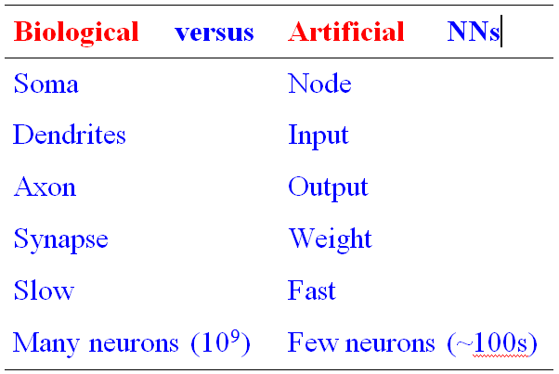
Biology Analogy

Slide 138
Elements of ANN
Processing element (PE)
Network architecture
  Hidden layers
  Parallel processing
Network information processing
  Inputs
  Outputs
  Connection weights
  Summation function

Slide 139
Elements of ANN
Neural Network with One Hidden Layer

Slide 140
Elements of ANN
Summation Function for a Single Neuron (a), and
Several Neurons (b)

Slide 141
Elements of ANN
Transformation (Transfer) Function
  Linear function
  Sigmoid (logical activation) function [0 1]
  Tangent Hyperbolic function [-1 1]
Threshold value?

Slide 142
Neural Network Architectures
Architecture of a neural network is driven by the task it is intended to address
  Classification, regression, clustering, general optimization, association, ….
Most popular architecture: Feedforward, multi-layered perceptron with backpropagation learning algorithm
  Used for both classification and regression type problems
Others – Recurrent, self-organizing feature maps, Hopfield networks, …

Slide 143
Neural Network Architectures
Feed-Forward Neural Networks
Feed-forward MLP with 1 Hidden Layer

Slide 144
Neural Network Architectures
Recurrent Neural Networks

Slide 145
Testing a Trained ANN Model
Data is split into three parts
  Training (~60%)
  Validation (~20%)
  Testing (~20%)
k-fold cross validation
  Less bias
  Time consuming

Slide 146
AN Learning Process
A Supervised Learning Process
Three-step process:
1. Compute temporary outputs.
2. Compare outputs with desired targets.
3. Adjust the weights and repeat the process.

Slide 147
Backpropagation Learning
Backpropagation of Error for a Single Neuron

Slide 148
Backpropagation Learning
The learning algorithm procedure
  Initialize weights with random values and set other network parameters
  Read in the inputs and the desired outputs
  Compute the actual output (by working forward through the layers)
  Compute the error (difference between the actual and desired output)
  Change the weights by working backward through the hidden layers
  Repeat steps 2-5 until weights stabilize

Slide 149
Support Vector Machines (SVM)
SVM are among the most popular machine-learning techniques.
SVM belong to the family of generalized linear models… (capable of representing non-linear relationships in a linear fashion).
SVM achieve a classification or regression decision based on the value of the linear combination of input features.
Because of their architectural similarities, SVM are also closely associated with ANN.

Slide 150
Support Vector Machines (SVM)
Goal of SVM: to generate mathematical functions that map input variables to desired outputs for classification or regression type prediction problems.
  First, SVM uses nonlinear kernel functions to transform non-linear relationships among the variables into linearly separable feature spaces.
  Then, the maximum-margin hyperplanes are constructed to optimally separate different classes from each other based on the training dataset.
SVM has solid mathematical foundation!

Slide 151
Support Vector Machines (SVM)
A hyperplane is a geometric concept used to describe the separation surface between different classes of things.
  In SVM, two parallel hyperplanes are constructed on each side of the separation space with the aim of maximizing the distance between them.
A kernel function in SVM uses the kernel trick (a method for using a linear classifier algorithm to solve a nonlinear problem)
  The most commonly used kernel function is the radial basis function (RBF).

Slide 152
Support Vector Machines (SVM)
Many linear classifiers (hyperplanes) may separate the data

Slide 153
How Does an SVM Work?
Following a machine-learning process, an SVM learns from the historic cases.
The Process of Building SVM
  1. Preprocess the data
    Scrub and transform the data.
  2. Develop the model.
    Select the kernel type (RBF is often a natural choice).
    Determine the kernel parameters for the selected kernel type.
    If the results are satisfactory, finalize the model; otherwise change the kernel type and/or kernel parameters to achieve the desired accuracy level.
  3. Extract and deploy the model.

Slide 154
The Process of Building an SVM

Slide 155
SVM Applications
SVMs are the most widely used kernel-learning algorithms for wide range of classification and regression problems
SVMs represent the state-of-the-art by virtue of their excellent generalization performance, superior prediction power, ease of use, and rigorous theoretical foundation
Most comparative studies show its superiority in both regression and classification type prediction problems.
SVM versus ANN?

Slide 156
k-Nearest Neighbor Method (k-NN)
ANNs and SVMs → time-demanding, computationally intensive iterative derivations
k-NN is a simplistic and logical prediction method, that produces very competitive results
k-NN is a prediction method for classification as well as regression types (similar to ANN & SVM)
k-NN is a type of instance-based learning (or lazy learning) – most of the work takes place at the time of prediction (not at modeling)
k : the number of neighbors used

Slide 157
k-Nearest Neighbor Method (k-NN)
The answer depends on the value of k

Slide 158
The Process of k-NN Method

Slide 159
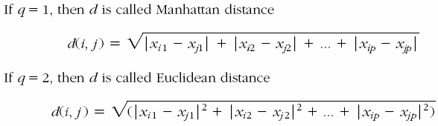
k-NN Model Parameter
Similarity Measure: The Distance Metric
  Numeric versus nominal values?

Slide 160
k-NN Model Parameter
Number of Neighbors (the value of k)
  The best value depends on the data
  Larger values reduce the effect of noise but also make boundaries between classes less distinct
  An “optimal” value can be found heuristically
Cross Validation is often used to determine the best value for k and the distance measure

Slide 161
End of the Chapter
Questions, comments

Slide 162
Business Intelligence and Analytics: Systems for Decision Support
(10th Edition)
Chapter 7:
Text Analytics, Text Mining, and Sentiment Analysis

Slide 163
Text Mining Concepts
85-90 percent of all corporate data is in some kind of unstructured form (e.g., text)
Unstructured corporate data is doubling in size every 18 months
Tapping into these information sources is not an option, but a need to stay competitive
Answer: text mining
  A semi-automated process of extracting knowledge from unstructured data sources
  a.k.a. text data mining or knowledge discovery in textual databases

Slide 164
Data Mining versus Text Mining
Both seek for novel and useful patterns
Both are semi-automated processes
Difference is the nature of the data:
  Structured versus unstructured data
  Structured data: in databases
  Unstructured data: Word documents, PDF files, text excerpts, XML files, and so on
Text mining – first, impose structure to the data, then mine the structured data.

Slide 165
Text Mining Concepts
Benefits of text mining are obvious, especially in text-rich data environments
  e.g., law (court orders), academic research (research articles), finance (quarterly reports), medicine (discharge summaries), biology (molecular interactions), technology (patent files), marketing (customer comments), etc.
Electronic communication records (e.g., Email)
  Spam filtering
  Email prioritization and categorization
  Automatic response generation

Slide 166

Text Mining Application Area
Information extraction
Topic tracking
Summarization
Categorization
Clustering
Concept linking
Question answering

Slide 167
Text Mining Terminology
Unstructured or semi-structured data
Corpus (and corpora)
Terms
Concepts
Stemming
Stop words (and include words)
Synonyms (and polysemes)
Tokenizing

Slide 168
Text Mining Terminology
Term dictionary
Word frequency
Part-of-speech tagging
Morphology
Term-by-document matrix
  Occurrence matrix
Singular value decomposition
  Latent semantic indexing

Slide 169
Natural Language Processing (NLP)
Structuring a collection of text
  Old approach: bag-of-words
  New approach: natural language processing
NLP is …
  a very important concept in text mining
  a subfield of artificial intelligence and computational linguistics
  the studies of "understanding" the natural human language
Syntax versus semantics-based text mining

Slide 170
Natural Language Processing (NLP)
What is “Understanding” ?
  Human understands, what about computers?
  Natural language is vague, context driven
  True understanding requires extensive knowledge of a topic
  Can/will computers ever understand natural language the same/accurate way we do?

Slide 171
Natural Language Processing (NLP)
Challenges in NLP
  Part-of-speech tagging
  Text segmentation
  Word sense disambiguation
  Syntax ambiguity
  Imperfect or irregular input
  Speech acts
Dream of AI community
  to have algorithms that are capable of automatically reading and obtaining knowledge from text

Slide 172
Natural Language Processing (NLP)
WordNet
  A laboriously hand-coded database of English words, their definitions, sets of synonyms, and various semantic relations between synonym sets.
  A major resource for NLP.
  Need automation to be completed.
Sentiment Analysis
  A technique used to detect favorable and unfavorable opinions toward specific products and services
  SentiWordNet

Slide 173
NLP Task Categories
Information retrieval, information extraction
Named-entity recognition
Question answering
Automatic summarization
Natural language generation & understanding
Machine translation
Foreign language reading & writing
Speech recognition
Text proofing, optical character recognition

Slide 174
Text Mining Applications
Marketing applications
  Enables better CRM
Security applications
  ECHELON, OASIS
  Deception detection (…)
Medicine and biology
  Literature-based gene identification (…)
Academic applications
  Research stream analysis

Slide 175
Text Mining Process
The three-step text mining process

Slide 176
Text Mining Process
Step 1: Establish the corpus
  Collect all relevant unstructured data (e.g., textual documents, XML files, emails, Web pages, short notes, voice recordings…)
  Digitize, standardize the collection (e.g., all in ASCII text files)
  Place the collection in a common place (e.g., in a flat file, or in a directory as separate files)

Slide 177
Text Mining Process
Step 2: Create the Term-by-Document Matrix (TDM)

Slide 178
Text Mining Process
Step 2: Create the Term-by-Document Matrix (TDM)
  Should all terms be included?
    Stop words, include words
    Synonyms, homonyms
    Stemming
  What is the best representation of the indices (values in cells)?
    Row counts; binary frequencies; log frequencies;
    Inverse document frequency

Slide 179
Text Mining Process
Step 2: Create the Term–by–Document Matrix (TDM)
  TDM is a sparse matrix. How can we reduce the dimensionality of the TDM?
    Manual - a domain expert goes through it
    Eliminate terms with very few occurrences in very few documents (?)
    Transform the matrix using singular value decomposition (SVD)
    SVD is similar to principle component analysis

Slide 180
Text Mining Process
Step 3: Extract patterns/knowledge
  Classification (text categorization)
  Clustering (natural groupings of text)
    Improve search recall
    Improve search precision
    Scatter/gather
    Query-specific clustering
  Association
  Trend Analysis (…)

Slide 181
Text Mining Tools
Commercial Software Tools
  IBM SPSS Modler - Text Miner
  SAS Enterprise Miner – Text Miner
  Statistical Data Miner – Text Miner
  ClearForest, …
Free Software Tools
  RapidMiner
  GATE
  Spy-EM, …

Slide 182
Sentiment Analysis Overview
Sentiment → belief, view, opinion, conviction
Sentiment analysis → opinion mining, subjectivity analysis, and appraisal extraction
The goal is to answer the question:
“What do people feel about a certain topic?”
Explicit versus Implicit sentiment
Sentiment polarity
  Positive versus Negative
  … versus Neutral?

Slide 183
Sentiment Analysis Applications
Voice of the customer (VOC)
Voice of the Market (VOM)
Voice of the Employee (VOE)
Brand Management
Financial Markets
Politics
Government Intelligence
… others

Slide 184
Sentiment
Analysis
Process

Slide 185
Sentiment Analysis Process
Step 1 – Sentiment Detection
  Comes right after the retrieval and preparation of the text documents
  It is also called detection of objectivity
    Fact [= objectivity] versus Opinion [= subjectivity]
Step 2 – N-P Polarity Classification
  Given an opinionated piece of text, the goal is to classify the opinion as falling under one of two opposing sentiment polarities
    N [= negative] versus P [= positive]

Slide 186
Sentiment Analysis Process
Step 3 – Target Identification
  The goal of this step is to accurately identify the target of the expressed sentiment (e.g., a person, a product, an event, etc.)
    Level of difficulty → the application domain
Step 4 – Collection and Aggregation
  Once the sentiments of all text data points in the document are identified and calculated, they are to be aggregated
    Word → Statement → Paragraph → Document

Slide 187
Sentiment Analysis and
Speech Analytics
Speech analytics – analysis of voice
  Content versus other Voice Features
Two Approaches
  The Acoustic Approach
    Intensity, Pitch, Jitter, Shimmer, etc.
  The Linguistic Approach
    Lexical: words, phrases, etc.
    Disfluencies: filled pauses, hesitation, restarts, etc.
    Higher semantics: taxonomy/ontology, pragmatics
Many uses and use cases exist

Slide 188
End of the Chapter
Questions, comments

Slide 189
Business Intelligence and Analytics: Systems for Decision Support
(10th Edition)
Chapter 8:
Web Analytics, Web Mining, and Social Analytics

Slide 190
Web Mining Overview
Web is the largest repository of data
Data is in HTML, XML, text format
Challenges (of processing Web data)
  The Web is too big for effective data mining
  The Web is too complex
  The Web is too dynamic
  The Web is not specific to a domain
  The Web has everything
Opportunities and challenges are great!

Slide 191
Web Mining
Web mining (or Web data mining) is the process of discovering intrinsic relationships from Web data (textual, linkage, or usage)
Is it the same as data mining on data generated on the Internet?
Web data?
  Content, Link, Log, …
Web Mining versus Web Analytics
  Look at the simple taxonomy on the next slide

Slide 192
Web Mining

Slide 193
Web Content/Structure Mining
Mining the textual content on the Web
Data collection via Web Crawlers/Spiders
Web pages include hyperlinks
  Authoritative pages
  Hubs
  hyperlink-induced topic search (HITS) alg.

Slide 194
Search Engines
Google, Bing, Yahoo, …
For what reason do you use search engines?
Search engine is a software program that searches for documents (Internet sites or files) based on the keywords (individual words, multi-word terms, or a complete sentence) that users have provided that have to do with the subject of their inquiry
They are the workhorses of the Internet

Slide 195
Structure of a
Typical Internet Search Engine

Slide 196
Anatomy of a Search Engine
Development Cycle
  Web Crawler
  Document Indexer
  Steps
    Step 1 – Pre-Processing the Documents
      Collecting, organizing, and storing
    Step 2 – Parsing the Documents
    Step 3 – Creating the Term-by-Document Matrix
      How to represent the values (numeric, binary, …)
      Term Frequency / Inverse Document Frequency

Slide 197
Anatomy of a Search Engine
Response Cycle
  Query Analyzer
  Document Matcher/Ranker
How does Google do it?
  Googlebot
  Google indexer
  Google Query Processor

Slide 198
Search Engine Optimization (SEO)
It is the intentional activity of affecting the visibility of an e-commerce site or a Web site in a search engine’s natural (unpaid or organic) search results
Part of an Internet marketing strategy
Based on knowing how a search engine works
  Content, HTML, keywords, external links, …
Indexing based on …
  Webmaster submission of URL
  Proactively and continuously crawling the Web

Slide 199
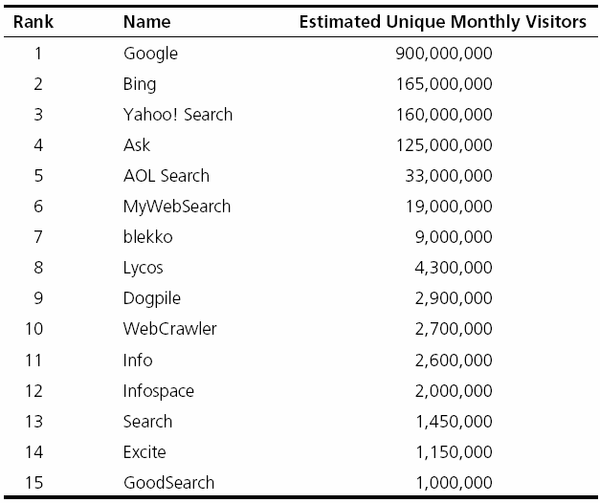
Top 15 Most Popular Search Engines (by eBizMBA, March 2013)

Slide 200
Methods for
Search Engine Optimization
Search engine recommended techniques (White-Hat SEO)
  Producing results based on good site design, accurate content (for users, not engines)
Search engine disapproved techniques (Black-Hat SEO)
  Spamdexing? (search spam, search engine spam, or search engine poisoning)
  Deception (what is shown is different to human and machine/spider)

Slide 201
Web Usage Mining
→ Web Analytics!
Extraction of information from data generated through Web page visits and transactions…
  data stored in server access logs, referrer logs, agent logs, and client-side cookies
  user characteristics and usage profiles
  metadata, such as page attributes, content attributes, and usage data
Clickstream data, clickstream analysis

Slide 202
Web Usage Mining
Web usage mining applications
  Determine the lifetime value of clients
  Design cross-marketing strategies across products
  Evaluate promotional campaigns
  Target electronic ads and coupons at user groups based on user access patterns
  Predict user behavior based on previously learned rules and users' profiles
  Present dynamic information to users based on their interests and profiles
  …

Slide 203
Web Usage Mining
(Clickstream Analysis)

Slide 204
Web Analytics Metrics
Provides near-real-time data to deliver invaluable information to …
  Improve site usability
  Manage marketing efforts
  Better document ROI, …
Web analytics metric categories:
  Web site usability: How were they using my Web site?
  Traffic sources: Where did they come from?
  Visitor profiles: What do my visitors look like?
  Conversion statistics: What does all this mean for the business?

Slide 205
Web Analytics Metrics
- Web Site Usability
Web Site Usability
Page views
Time on site
Downloads
Click map
Click paths
Traffic Source
Referral Web sites
Search engines
Direct
Offline campaigns
Online campaigns

Slide 206
Web Analytics Metrics
- Web Site Usability
Visitor Profiles
Keywords
Content groupings
Geography
Time of day
Landing page
Conversion Statistics
New visitors
Returning visitors
Leads
Sales/conversions
Abandonment rates

Slide 207
Web Analytics Tools
Plenty of them exist, and numbers are increasing (Web-based versus downloadable)
  Google Web Analytics (google.com/analytics)
  Yahoo! Web Analytics (web.analytics.yahoo.com)
  Open Web Analytics (openwebanalytics.com)
  Piwik (PIWIK.ORG)
  FireStats (firestats.cc)
  Site Meter (sitemeter.com)
  Woopra (woopra.com)
  AWStats (awstats.org)
  Snoop (reinvigorate.net) …

Slide 208
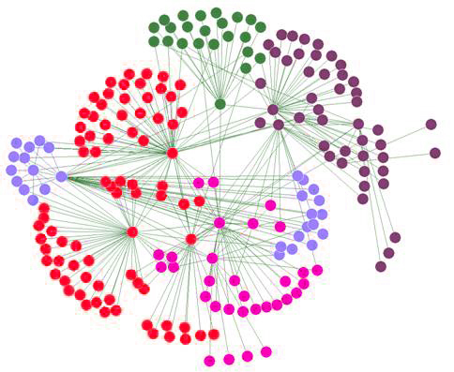
Social Analytics
Social Network Analysis
Social Network - social structure composed of individuals linked to each other
Analysis of social dynamics
Interdisciplinary field
  Social psychology
  Sociology
  Statistics
  Graph theory

Slide 209
Social Analytics
Social Network Analysis
Social Networks help study relationships between individuals, groups, organizations, societies
  Self organizing
  Emergent
  Complex
Typical social network types
  Communication networks, community networks, criminal networks, innovation networks, …

Slide 210
Social Analytics
Social Network Analysis Metrics
Connections
  Homophily
  Multiplexity
  Network closure
  Propinquity
Segmentation
  Cliques and social circles
  Clustering coefficient
  Cohesion
Distribution
  Bridge
  Centrality
  Density
  Structural holes
  Tie strength

Slide 211
Social Media
Definitions and Concepts
Enabling technologies of social interactions among people
Relies on enabling technologies of Web 2.0
Takes on many different forms
  Internet forums, Web logs, social blogs, microblogging, wikis, social networks, podcasts, pictures, video, and product reviews
Different types of social media
  Based on media research and social process

Slide 212
Different Types of Social Media
Collaborative projects (e.g., Wikipedia)
Blogs and microblogs (e.g., Twitter)
Content communities (e.g., YouTube)
Social networking sites (e.g., Facebook)
Virtual game worlds (e.g., World of Warcraft), and
Virtual social worlds (e.g., Second Life)
--Kaplan and Haenlein (2010)

Slide 213
Social versus Industrial Media
Web-based social media are different from traditional/industrial media, such as newspapers, television, and film
Differentiating characteristics
  Quality
  Reach
  Frequency
  Accessibility
  Usability
  Immediacy
  Updatability

Slide 214
Social Media Analytics
It is the systematic and scientific ways to consume the vast amount of content created by Web-based social media outlets, tools, and techniques for the betterment of an organization’s competitiveness
Fastest growing movement in analytics
Social Media
Tweeter
Facebook
LinlkedIn
…
Insights
Solutions
Course of Actions
…

Slide 215
Social Media Analytics
HBR Analytic Services survey (HBR, 2010)
  75% of the companies did not know where their customers are talking about them
  31% do not measure effectiveness of social media
  only 23% are using social media analytics tools
  7% are able to integrate social media into marketing
Measuring the Social Media Impact
  Descriptive analytics – simple counts/statistics
  Social network analysis
  Advanced analytics – predictive analytics, text mining

Slide 216
Best Practices in
Social Media Analytics
Think of measurement as a guidance system, not a rating system
Track the elusive sentiment
Continuously improve the accuracy of text analysis
Look at the ripple effect
Look beyond the brand
Identify your most powerful influencers
Look closely at the accuracy of your analytic tool
Incorporate social media intelligence into planning

Slide 217
Social Media Analytics
Tools and Vendors
Attensity360
Radian6/Salesforce Cloud
Sysomos
Collective Intellect
Webtrends
Crimson Hexagon
Converseon
SproutSocial …
Twitter
Facebook
YouTube
LinkedIn
Flickr
…

Slide 218
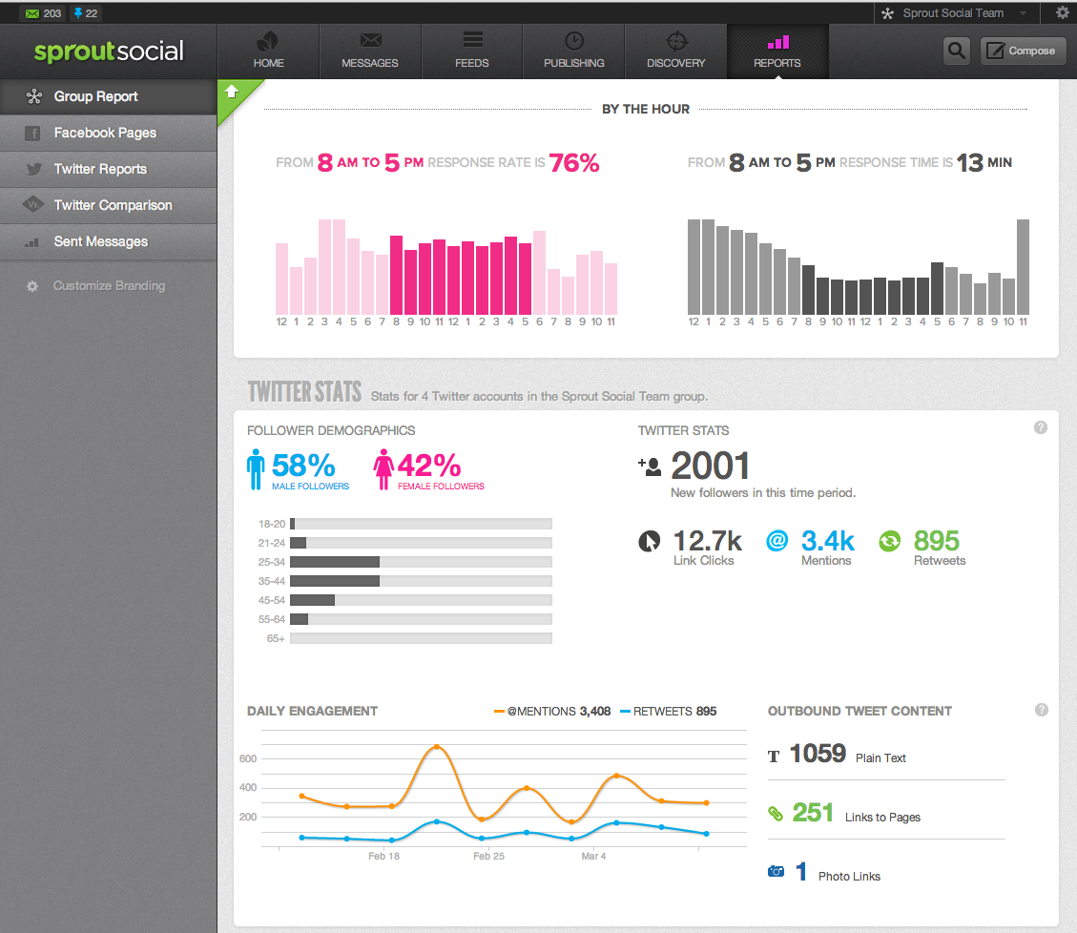
Social Media Analytics

Slide 219
End of the Chapter
Questions, comments

Slide 220
Business Intelligence and Analytics: Systems for Decision Support
(10th Edition)
Chapter 9:
Model-Based Decision Making: Optimization and Multi-Criteria Systems

Slide 221
Decision Support Systems Modeling
DSS modeling (optimization & simulation) contribute to organizational success. Examples include:
  Pillowtex (see ProModel, 2013),
  Fiat (see ProModel, 2006),
  Procter & Gamble (see Camm et al., 1997),
  and others.
  INFORMS publications such as Interfaces, ORMS Today, and Analytics magazine have plenty of such example cases

Slide 222
Major Modeling Issues
Problem identification and environmental analysis (information collection)
Variable identification
  Influence diagrams, cognitive maps
Forecasting/predicting
  More information leads to better prediction
Multiple models: An MSS can include several models, each of which represents a different part of the decision-making problem
  Categories of models >>>
Model management – DBMS vs. MBDM

Slide 223
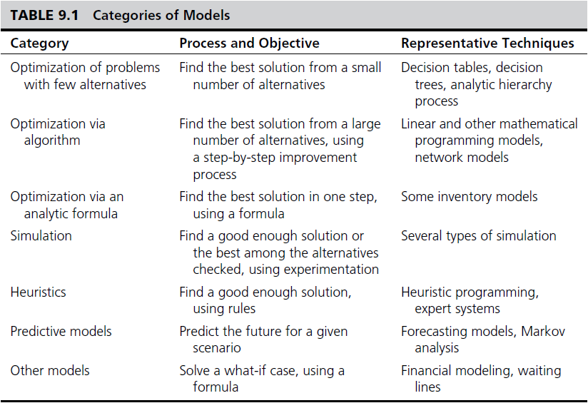
Categories of Models

Slide 224
Model Categories
Static and Dynamic Models
Static Analysis
  Single snapshot of the situation
  Single interval
  Steady state
Dynamic Analysis
  Dynamic models
  Evaluate scenarios that change over time
  Time dependent
  Represents trends and patterns over time
  More realistic: Extends static models

Slide 225
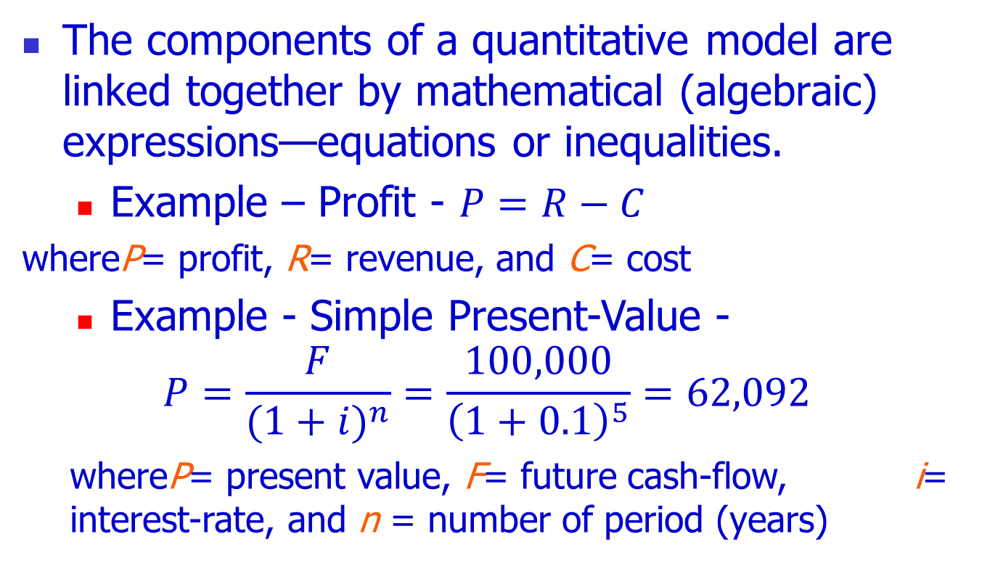
The Structure of a
Mathematical Model
The components of a quantitative model are linked together by mathematical (algebraic) expressions—equations or inequalities.
  Example – Profit - $P=R−C$
whereP= profit, R= revenue, and C= cost
  Example - Simple Present-Value -
$$P=\frac{F}{{(1+i)}^{n}}=\frac{100,000}{{\left(1+0.1\right)}^{5}}=62,092$$
  whereP= present value, F= future cash-flow, i= interest-rate, and n = number of period (years)

Slide 226
Modeling and Decision Making -
Under Certainty, Uncertainty, and Risk
Certainty
  Assume complete knowledge
  All potential outcomes are known
  May yield optimal solution
Uncertainty
  Several outcomes for each decision
  Probability of each outcome is unknown
  Knowledge would lead to less uncertainty
Risk analysis (probabilistic decision making)
  Probability of each of several outcomes occurring
  Level of uncertainty => Risk (expected value)

Slide 227
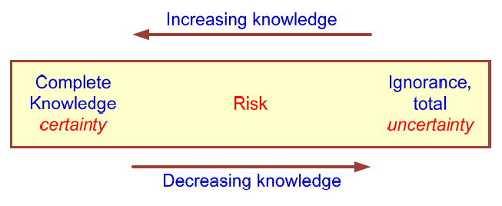
Modeling and Decision Making -
Under Certainty, Uncertainty, and Risk
The Zones of Decision Making

Slide 228
Decision Modeling with Spreadsheets
Spreadsheet
  Most popular end-user modeling tool
  Flexible and easy to use
  Powerful functions (add-in functions)
  Programmability (via macros)
  What-if analysis and goal seeking
  Simple database management
  Seamless integration of model and data
  Incorporates both static and dynamic models
  Examples: Microsoft Excel, Lotus 1-2-3

Slide 229
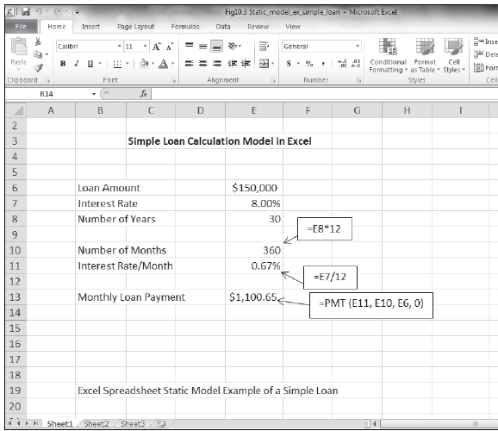
Excel spreadsheet - static model example: (Simple loan calculation of monthly payments)
Static model example:

Slide 230
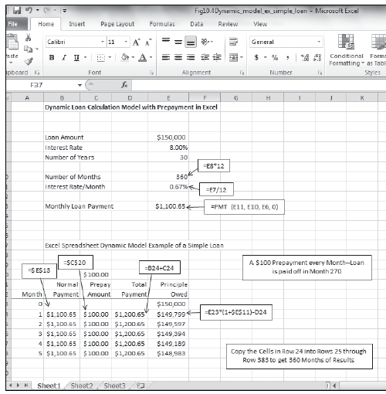
Excel spreadsheet - Dynamic model example:
Simple loan calculation of monthly payments and effects of prepayment

Slide 231
Optimization via Mathematical Programming
Mathematical Programming
  A family of tools designed to help solve managerial problems in which the decision maker must allocate scarce resources among competing activities to optimize a measurable goal
Optimal solution: The best possible solution to a modeled problem
  Linear programming (LP): A mathematical model for the optimal solution of resource allocation problems. All the relationships are linear.

Slide 232
Common Optimization Models
Product-mix problems (how many of each product to produce for max profit)
Transportation (minimize cost of shipments)
Assignment (best matching of objects)
Investment (maximizing rate of return)
Network optimization models for planning and scheduling
Replacement (capital budgeting), …

Slide 233
Multiple Goals, Sensitivity Analysis, What-If Analysis, and Goal Seeking
Multiple Goals
  Simple-goal vs. multiple goals
  Vast majority of managerial problems has multiple goals (objectives) to achieve
    Attaining simultaneous goals
  Methods of handling multiple goals
    Utility theory
    Goal programming
    Expression of goals as constraints, using LP
    A points system

Slide 234
Multiple Goals, Sensitivity Analysis, What-If Analysis, and Goal Seeking
Certain difficulties may arise when analyzing multiple goals
  Difficult to obtain a single organizational goal
  The importance of goals change over time
  Goals and sub-goals are viewed differently
  Goals change in response to other changes
  Dynamics of groups of decision makers
  Assessing the importance (priorities)
  …

Slide 235
Multiple Goals, Sensitivity Analysis, What-If Analysis, and Goal Seeking
Sensitivity analysis
  It is the process of assessing the impact of change in inputs on outputs
  Helps to …
    eliminate (or reduce) variables
    revise models to eliminate too-large sensitivities
    adding details about sensitive variables or scenarios
    obtain better estimates of sensitive variables
    alter a real-world system to reduce sensitivities
    …
  Can be automatic or trial and error

Slide 236
Multiple Goals, Sensitivity Analysis, What-If Analysis, and Goal Seeking
What-if analysis
  Assesses solutions based on changes in variables or assumptions (scenario analysis)
  What if we change our capacity at the milling station by 40% [what would be the impact]
Goal seeking
  Backwards approach, starts with the goal and determines values of inputs needed
  Example is break-even point determination
    In-order to break even (profit = 0), how many products do we have to sell each month

Slide 237
Decision Analysis with Decision Tables and Decision Trees
Decision Tables – a tabular representation of the decision situation (alternatives)
Investment Example
  Goal: maximize the yield after one year
  Yield depends on the status of the economy (the state of nature)
    Solid growth
    Stagnation
    Inflation

Slide 238
Decision Table -
Investment Example: Possible Situations
  1. If solid growth in the economy, bonds yield 12%; stocks 15%; time deposits 6.5%
  2. If stagnation, bonds yield 6%; stocks 3%; time deposits 6.5%
  3. If inflation, bonds yield 3%; stocks lose 2%; time deposits yield 6.5%

Slide 239
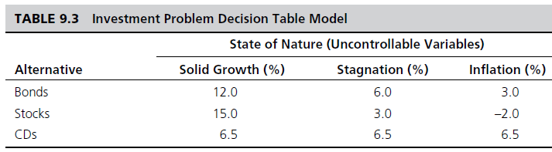
Decision Table
Investment Example: Decision Table
Payoff decision variables (alternatives)
Uncontrollable variables (states of economy)
Result variables (projected yield)
Tabular representation:

Slide 240
Decision Table
Investment Example: Treating Uncertainty
Optimistic approach
Pessimistic approach
Treating Risk/Uncertainty:
  Use known probabilities
  Expected values

Slide 241
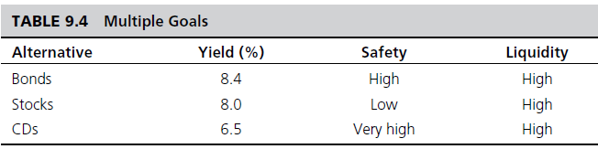
Decision Table
Investment Example: Multiple Goals
Multiple goals
  Yield, safety, and liquidity

Slide 242
Decision Trees
Graphical representation of relationships
Multiple criteria approach
Demonstrates complex relationships
Cumbersome, if many alternatives exists
Tools include
  Mind Tools Ltd., mindtools.com
  TreeAge Software Inc., treeage.com
  Palisade Corp., palisade.com

Slide 243
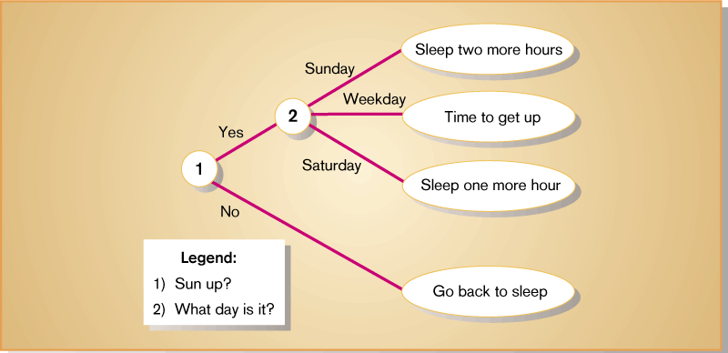
Decision Trees – An Example

Slide 244
Multi-Criteria Decision Making with Pairwise Comparisons
Having more than one criterion makes decision-making process complicated
Usually some type of weighing algorithm is used to analyze such problems
The Analytic Hierarchy Process
  Developed by Thomas Saaty (1995, 1996)
  A very popular technique for MCDM
  Popular Tools - ExpertChoice.com
  Web-based Tools - Web-HIPRE (hipre.aalto.fi)

Slide 245
End of the Chapter
Questions, comments

Slide 246
Business Intelligence and Analytics: Systems for Decision Support
(10th Edition)
Chapter 10:
Modeling and Analysis: Heuristic Search Methods and Simulation

Slide 247
Problem-Solving Search Methods
Search: choice phase of decision making
Search is the process of identifying the best possible solution / course of action [under limitations such as time, …]
Search techniques include
  analytical techniques,
  algorithms,
  blind searching, and
  heuristic searching

Slide 248
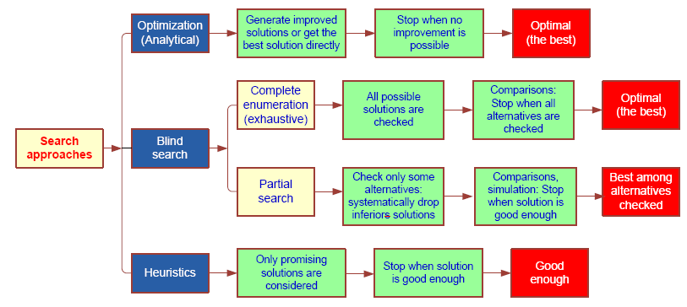
Problem-Solving Search Methods

Slide 249
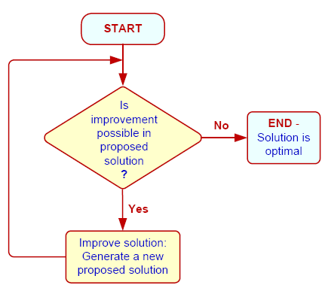
Problem-Solving Search Methods
- Algorithmic/Heuristic
Cuts the search space
Gets satisfactory solutions more quickly and less expensively
Finds good enough feasible solutions to complex problems
Heuristics can be
  Quantitative
  Qualitative (in ES)
Traveling Salesman Problem see the example next >>>

Slide 250

Traveling Salesman Problem
What is it?
  A traveling salesman must visit customers in several cities, visiting each city only once, across the country. Goal: Find the shortest possible route.
  Total number of unique routes (TNUR):
  TNUR = (1/2) (Number of Cities – 1)!
  Number of Cities TNUR
  5 12
  6 60
  9 20,160
  20 1.22 10¹⁸

Slide 251
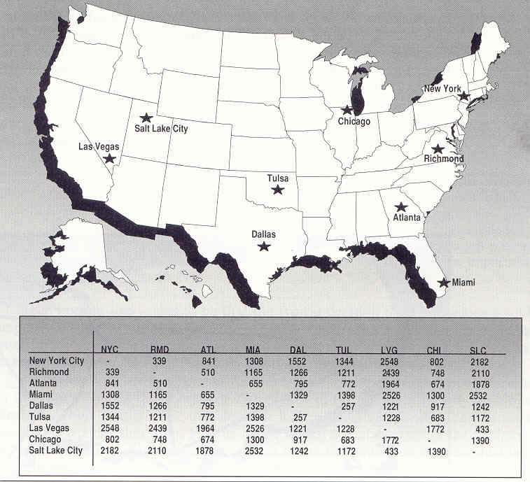
Traveling Salesman Problem

Slide 252
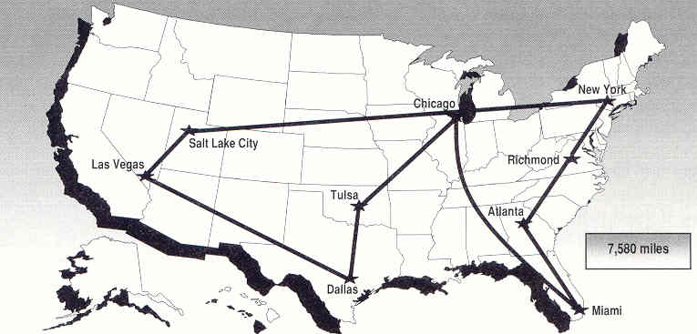
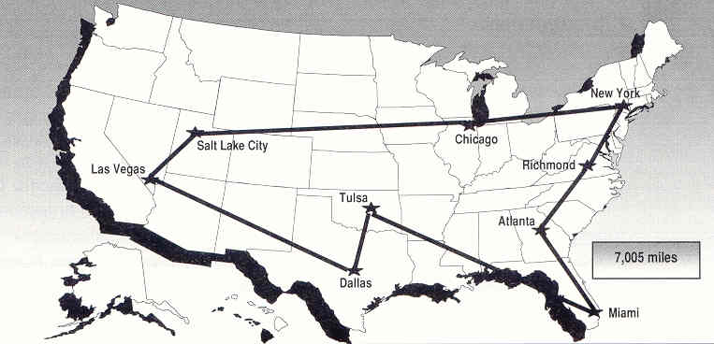
Traveling Salesman Problem
Rule 1: Starting from home base, go to the closest city
Rule 2: Always follow an exterior route

Slide 253
When to Use Heuristics
When to Use Heuristics?
  Inexact or limited input data
  Complex reality
  Reliable, exact algorithm not available
  Computation time excessive
  For making quick decisions
Limitations of Heuristics!
  Cannot guarantee an optimal solution

Slide 254
Modern Heuristic Methods
Tabu search
  Intelligent search algorithm
Genetic algorithms
  Survival of the fittest
Simulated annealing
  Analogy to Thermodynamics
Ant colony and other Meta-heuristics

Slide 255
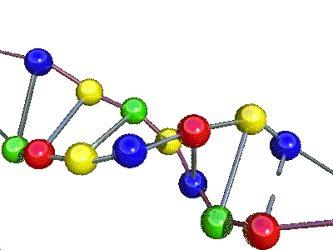
Genetic Algorithms
It is a popular heuristic search technique
Mimics the biological process of evolution
Genetic algorithms
  Software programs that “learn/search” in evolutionary manner, similar to the way biological systems evolve
An efficient, domain-independent search heuristic for a broad spectrum of problem domains
Main theme: Survival of the fittest
  Moving toward better and better solutions by letting only the fittest parents create the future generations

Slide 256
Evolutionary Algorithm
10010110
01100010
10100100
10011001
01111101
. . .
. . .
. . .
. . .
10010110
01100010
10100100
10011101
01111001
. . .
. . .
. . .
. . .
Elitism
Selection
Reproduction
. Crossover
. Mutation
Current
generation
Next
generation

Slide 257
GA Structure and GA Operators
Each candidate solution is called a chromosome
A chromosome is a string of genes
Chromosomes can copy themselves, mate, and mutate via evolution
In GA we use specific genetic operators
  Reproduction
    Crossover
    Mutation

Slide 258
Genetic Algorithms
Limitations of Genetic Algorithms
  Does not guarantee an optimal solution (often settles in a sub optimal solution / local minimum)
  Not all problems can be put into GA formulation
  Development and interpretation of GA solutions requires both programming and statistical skills
  Relies heavily on the random number generators
  Locating good variables for a particular problem and obtaining the data for the variables is difficult
  Selecting methods by which to evolve the system requires experimentation and experience

Slide 259
Genetic Algorithm Applications
Dynamic process control
Optimization of induction rules
Discovery of new connectivity topologies (NNs)
Simulation of biological models of behavior
Complex design of engineering structures
Pattern recognition
Scheduling, transportation, and routing
Layout and circuit design
Telecommunication, graph-based problems, …

Slide 260
Simulation
Simulation is the “appearance” of reality
It is often used to conduct what-if analysis on the model of the actual system
It is a popular DSS technique for conducting experiments with a computer on a comprehensive model of the system to assess its dynamic behavior
Often used when the system is too complex for other DSS techniques

Slide 261
Major Characteristics of Simulation
Imitates reality and captures its richness both in shape and behavior
  “Represent” versus “Imitate”
Technique for conducting experiments
Descriptive, not normative tool
Often to “solve” [i.e., analyze] very complex systems/problems
Simulation should be used only when a numerical optimization is not possible

Slide 262
Advantages of Simulation
The theory is fairly straightforward
Great deal of time compression
Experiment with different alternatives
The model reflects manager’s perspective
Can handle wide variety of problem types
Can include the real complexities of problems
Produces important performance measures
Often it is the only DSS modeling tool for non-structured problems

Slide 263
Disadvantages of Simulation
Cannot guarantee an optimal solution
Slow and costly construction process
Cannot transfer solutions and inferences to solve other problems (problem specific)
So easy to explain/sell to managers, may lead to overlooking analytical solutions
Software may require special skills

Slide 264
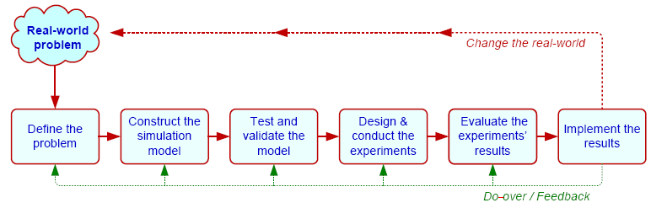
Simulation Methodology
Steps:
    1. Define problem 5. Conduct experiments
    2. Construct the model 6. Evaluate results
    3. Test and validate model 7. Implement solution
    4. Design experiments

Slide 265
Simulation Types
Probabilistic/Stochastic vs. Deterministic Simulation
  Uses probability distributions
Time-dependent vs. Time-independent Simulation
  Monte Carlo technique (X = A + B) [A, B, and X are all distributions]
Discrete Event vs. Continuous Simulation
Simulation Implementation
  Visual Simulation and/or Object-Oriented Simulation

Slide 266
Visual Interactive Simulation (VIS)
Visual interactive modeling (VIM), also called Visual Interactive Simulation or Visual interactive problem solving
Uses computer graphics to present the impact of different management decisions
Often integrated with 3G and GIS
Users can perform sensitivity analysis
Static or dynamic (animation) systems
Virtual reality, immersive, …

Slide 267
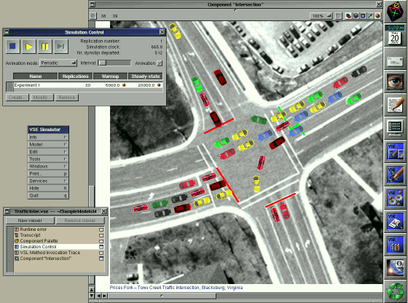
Traffic at an Intersection from the Orca Visual Simulation

Slide 268
Simulation Software
A comprehensive list can be found at
  orms-today.org/surveys/Simulation/Simulation.html
Simio LLC, simio.com
SAS Simulation, sas.com
Lumina Decision Systems, lumina.com
Oracle Crystal Ball, oracle.com
Palisade Corp., palisade.com
Rockwell Intl., arenasimulation.com …

Slide 269
Agent-Based Modeling
Agent - an autonomous computer program that observes and acts on an environment and directs its activity toward achieving specific goals
Relatively new technology
Other names include
  Software agents
  Wizards
  Knowbots, Both
  Intelligent software robots (Softbots) …

Slide 270
Agent-Based Modeling
Agent-based modeling (ABM) is a simulation modeling technique to support complex decision systems where a system is modeled as a set of autonomous decision-making units called agents
A bottom-up approach to simulation modeling
Agent-based modeling platforms
  SWARM (www.swarms.org),
  Netlogo (http://ccl.northwestern.edu/netlogo),
  RePast/Sugarscape (www.repast.sourceforge.net),
  …

Slide 271
End of the Chapter
Questions, comments

Slide 272
Business Intelligence and Analytics: Systems for Decision Support
(10th Edition)
Chapter 11:
Automated Decision Systems and Expert Systems

Slide 273
Automated Decision Systems
A relatively new approach to supporting decision making
a.k.a. Decision Automation Systems (DAS)
Often a rule-based system that provides a solution in a functional area
  “If only 70 percent of the seats on a flight from LA to NY are sold 3 days prior to departure, offer a discount of x to nonbusiness travelers”
Applies to repetitive/structured decisions

Slide 274
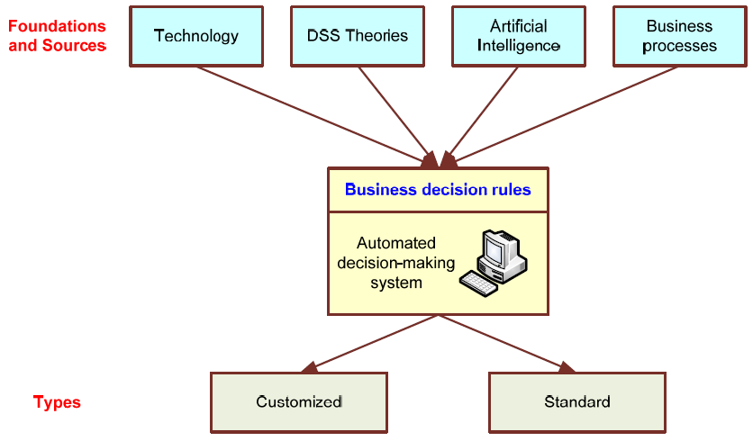
Automated Decision-Making Framework

Slide 275
Artificial Intelligence (AI)
Artificial intelligence (AI)
  A subfield of computer science, concerned with symbolic reasoning and problem solving
AI has many definitions…
  Behavior by a machine that, if performed by a human being, would be considered intelligent
  “…study of how to make computers do things at which, at the moment, people are better
  Theory of how the human mind works

Slide 276
AI Objectives
Make machines smarter (primary goal)
Understand what intelligence is
Make machines more intelligent & useful
Signs of intelligence…
  Learn or understand from experience
  Make sense out of ambiguous situations
  Respond quickly to new situations
  Use reasoning to solve problems
  Apply knowledge to manipulate the environment

Slide 277
Test for Intelligence
Turing Test for Intelligence
A computer can be considered to be smart only when a human interviewer, “conversing” with both an unseen human being and an unseen computer, can not determine which is which.
- Alan Turing

Slide 278
The AI Field…
The Disciplines and Applications of AI.
AI provides the scientific foundation for many commercial technologies

Slide 279
AI Areas
Major…
  Expert Systems
  Natural Language Processing
  Robotics and Sensory Systems
  Computer Vision and Scene Recognition
  Intelligent Computer-Aided Instruction
  Automated Programming, Neural Computing
Additional…
  Fuzzy Logic, Genetic Algorithms
  Game Playing, Intelligent Software Agents …

Slide 280
AI is Often Transparent in Many Commercial Products
Anti-lock Braking Systems (ABS)
Automatic Transmissions
Video Camcorders
Appliances
  Washers, Toasters, Stoves, …
Help Desk Software
Subway Control
…

Slide 281
Expert Systems (ES)
Is a computer program that attempts to imitate expert’s reasoning processes and knowledge in solving specific problems
Most Popular Applied AI Technology
  Enhance Productivity
  Augment Work Forces
Works best with narrow problem areas/tasks
Expert systems do not replace experts, but
  Make their knowledge and experience more widely available, and thus
  Permit non-experts to work better

Slide 282
Important Concepts in ES
Expert
A human being who has developed a high level of proficiency in making judgments in a specific domain
Expertise
  The set of capabilities that underlines the performance of human experts, including
    extensive domain knowledge,
    heuristic rules that simplify and improve approaches to problem solving,
    meta-knowledge and meta-cognition, and
    compiled forms of behavior that afford great economy in a skilled performance

Slide 283
Features and Concepts in ES
Experts / Expertise
  Degrees or levels of expertise
  Ratio of non-experts to experts → 100 to 1
Transferring Expertise
  From expert to computer to nonexperts via acquisition, representation, inferencing, transfer
Symbolic Reasoning / Inferencing
Deep Knowledge / Self Knowledge

Slide 284
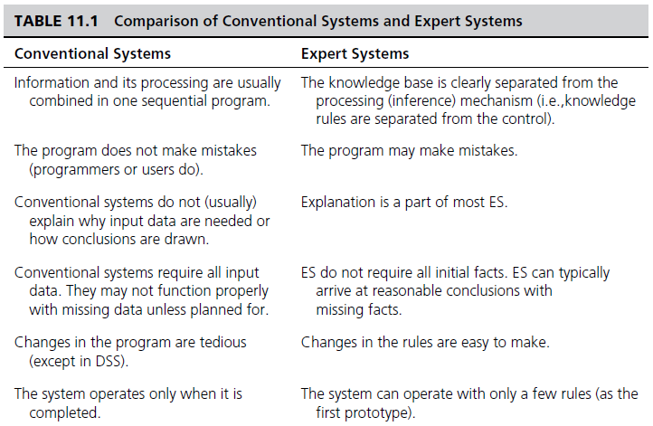
Conventional vs. Expert Systems
Continued…

Slide 285
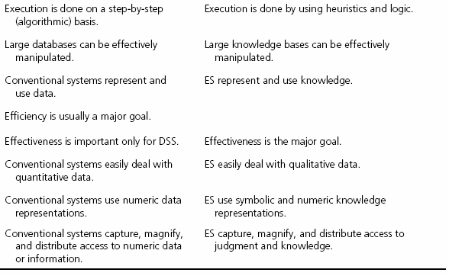
Conventional vs. Expert Systems
…

Slide 286
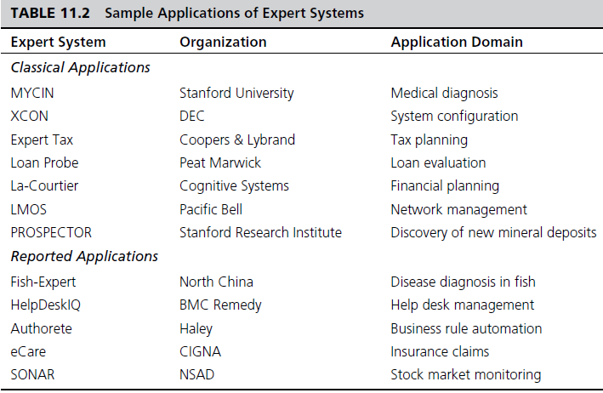
Applications of Expert Systems

Slide 287
Structure of Expert Systems
Development Environment
Consultation Environment
Major Components
  Knowledge acquisition subsystem
    Knowledge Engineer
  Knowledge Base
  Inference Engine
  User Interface
  Blackboard (workplace)
  Explanation subsystem (justifier)
  Knowledge-refining system

Slide 288
Structures of Expert
Systems

Slide 289
Knowledge Engineering (KE)
A set of intensive activities encompassing the acquisition of knowledge from human experts (and other information sources) and converting this knowledge into a repository (commonly called a knowledge base)
The primary goal of KE is to
  help experts articulate how they do what they do, and
  to document this knowledge in a reusable form
Narrow versus Broad definition of KE?

Slide 290
The Knowledge Engineering Process

Slide 291
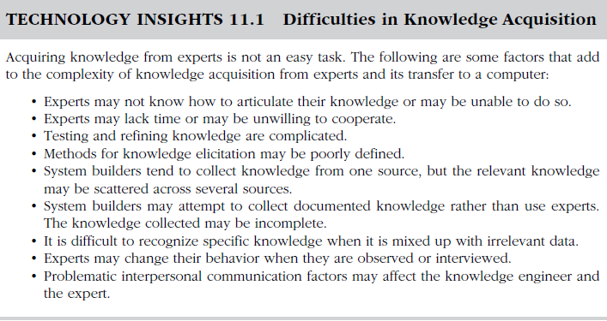
Difficulties in KE

Slide 292
Knowledge Engineering
Knowledge Validation/Verification
Evaluation is a broad concept - its objective is to assess an ES’s overall value
Validation versus Verification
Validation is the part of evaluation that deals with the performance of the system
Verification is building the system right or substantiating that the system is correctly implemented to its specifications

Slide 293
Knowledge Representation in ES
Expert knowledge must be represented in a computer-understandable format and organized properly in the knowledge base
The most common/popular way to represent human knowledge:
  Production rules
    Condition-Action pairs
    IF … THEN … ELSE …

Slide 294
Forms of Production Rules
IF premise, THEN conclusion
  IF your income is high, THEN your chance of being audited by the IRS is high
Conclusion, IF premise
  Your chance of being audited is high, IF your income is high
Inclusion of ELSE
  IF your income is high, OR your deductions are unusual, THEN your chance of being audited by the IRS is high, ELSE your chance of being audited is low
More complex rules…

Slide 295
Knowledge and Inference Rules
Knowledge rules (declarative rules), state all the facts and relationships about a problem
  Knowledge rules are stored in the knowledge base
Inference rules (procedural rules), advise on how to solve a problem, given that certain facts are known
  Inference rules contain rules about rules (metarules)
  Inference rules become part of the inference engine
  Example:
    IF needed data is not known THEN ask the user
    IF more than one rule applies THEN fire the one with the highest priority value first

Slide 296
Inferencing in ES
Inference is the process of chaining multiple rules together based on available data
  Forward chaining
  A data-driven search in a rule-based system.
  If the premise clauses match the situation, then the process attempts to assert the conclusion.
  Backward chaining
  A goal-driven search in a rule-based system.
  It begins with the action clause of a rule and works backward through a chain of rules in an attempt to find a verifiable set of condition clauses.

Slide 297
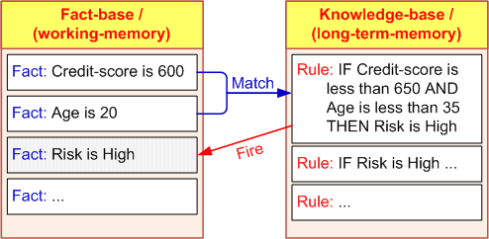
Inferencing with Rules:
Forward and Backward Chaining
Firing a rule
  When all of the rule's hypotheses (the “if parts”) are satisfied, a rule said to be FIRED
  Inference engine checks every rule in the knowledge base in a forward or backward direction to find rules that can be FIRED
  Continues until no more rules can fire, or until a goal is achieved

Slide 298
Inferencing – Backward Chaining
Goal-driven: Start from a potential conclusion (hypothesis), then seek evidence that supports (or contradicts with) it
Often involves formulating and testing intermediate hypotheses (or sub-hypotheses)
Investment Decision: Variable Definitions
  A = Have $10,000
  B = Younger than 30
  C = Education at college level
  D = Annual income > $40,000
  E = Invest in securities
  F = Invest in growth stocks
  G = Invest in IBM stock
Knowledge Base
Rule 1: A & C -> E
Rule 2: D & C -> F
Rule 3: B & E -> F (invest in growth stocks)
Rule 4: B -> C
Rule 5: F -> G (invest in IBM)

Slide 299
Inferencing – Forward Chaining
Data-driven: Start from available information as it becomes available, then try to draw conclusions
Which One to Use?
  If all facts available up front - forward chaining
  Diagnostic problems - backward chaining
Knowledge Base
Rule 1: A & C -> E
Rule 2: D & C -> F
Rule 3: B & E -> F (invest in growth stocks)
Rule 4: B -> C
Rule 5: F -> G (invest in IBM)
FACTS:
A is TRUE
B is TRUE

Slide 300
Inferencing Issues
How do we choose between BC and FC
  Follow how a domain expert solves the problem
    If the expert first collect data then infer from it
    => Forward Chaining
    If the expert starts with a hypothetical solution and then attempts to find facts to prove it => Backward Chaining
How to handle conflicting rules
  IF A & B THEN C
  IF X THEN C
  Establish a goal and stop firing rules when goal is achieved
  Fire the rule with the highest priority
  Fire the most specific rule
  Fire the rule that uses the data most recently entered

Slide 301
Inferencing with Uncertainty
- Theory of Certainty
Certainty Factors and Beliefs
Uncertainty is represented as a Degree of Belief
Express the Measure of Belief
Manipulate degrees of belief while using knowledge-based systems
Certainty Factors (CF) express belief in an event based on evidence (or the expert's assessment)
  1.0 or 100 = absolute truth (complete confidence)
  0 = certain falsehood
CFs are NOT probabilities
CFs need not sum to 100

Slide 302
Inferencing with Uncertainty
Combining Certainty Factors
Combining Several Certainty Factors in One Rule where parts are combined using AND and OR logical operators
AND
  IF inflation is high, CF = 50 percent, (A), AND
  unemployment rate is above 7, CF = 70 percent, (B), AND
  bond prices decline, CF = 100 percent, (C)
  THEN stock prices decline
  CF(A, B, and C) = Minimum[CF(A), CF(B), CF(C)]
  => The CF for “stock prices to decline” = 50 percent
  The chain is as strong as its weakest link

Slide 303
Inferencing with Uncertainty
Combining Certainty Factors
OR
  IF inflation is low, CF = 70 percent, (A), OR
  bond prices are high, CF = 85 percent, (B)
  THEN stock prices will be high
  CF(A, B) = Maximum[CF(A), CF(B)]
  => The CF for “stock prices to be high” = 85 percent
  Notice that in OR only one IF premise need to be true

Slide 304
Inferencing with Uncertainty
Combining Certainty Factors
Combining two or more rules
  Example:
    R1: IF the inflation rate is less than 5 percent,
    THEN stock market prices go up (CF = 0.7)
    R2: IF unemployment level is less than 7 percent,
    THEN stock market prices go up (CF = 0.6)
  Inflation rate = 4 percent and the unemployment level = 6.5 percent
  Combined Effect
    CF(R1,R2) = CF(R1) + CF(R2)[1 - CF(R1)]; or
    CF(R1,R2) = CF(R1) + CF(R2) - CF(R1) × CF(R2)

Slide 305
Explanation as a Metaknowledge
Explanation
  Human experts justify and explain their actions
  … so should ES
  Explanation: an attempt by an ES to clarify reasoning, recommendations, other actions (asking a question)
  Explanation facility = Justifier
Explanation Purposes…
  Make the system more intelligible
  Uncover shortcomings of the knowledge bases
  Explain unanticipated situations
  Satisfy users’ psychological and/or social needs, …

Slide 306
Two Basic Explanations
Why Explanations - Why is a fact requested?
How Explanations - To determine how a certain conclusion or recommendation was reached
  Some simple systems - only at the final conclusion
  Most complex systems provide the chain of rules used to reach the conclusion
Explanation is essential in ES
Used for training and evaluation

Slide 307
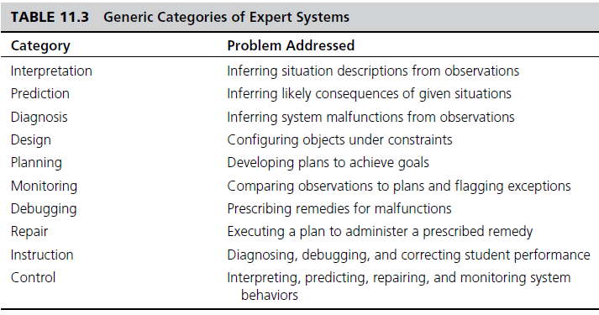
Problem Areas Suitable For Expert Systems

Slide 308
Development of ES
Defining the nature and scope of the problem
Identifying proper experts
Acquiring knowledge
  Knowledge engineer
Selecting the Building Tools
  Shells versus Complete Development
Coding the system
Evaluating and Launching the System

Slide 309
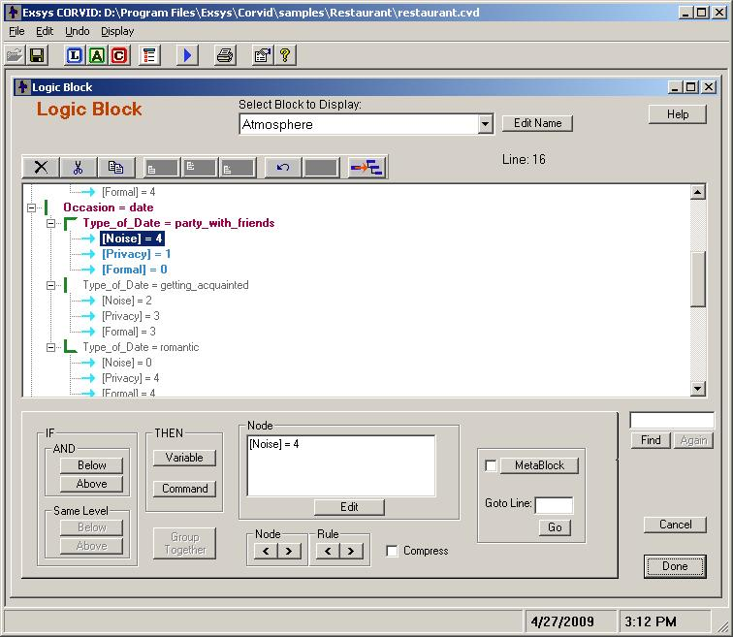
A Popular Expert System Shell

Slide 310



Problem Areas Addressed by ES
Interpretation systems
Prediction systems
Diagnostic systems
Repair systems
Design systems
Planning systems
Monitoring systems
Debugging systems
Instruction systems
Control systems, …

Slide 311
End of the Chapter
Questions, comments

Slide 312
Business Intelligence and Analytics: Systems for Decision Support
(10th Edition)
Chapter 12:
Knowledge Management and Collaborative Systems

Slide 313
Introduction to
Knowledge Management
Knowledge management concepts and definitions
  Knowledge management
  The active management of the expertise in an organization. It involves collecting, categorizing, and disseminating knowledge
  Intellectual capital
  The invaluable knowledge of an organization’s employees

Slide 314
Introduction to
Knowledge Management
Knowledge is
  information that is contextual, relevant, and actionable
  understanding, awareness, or familiarity acquired through education or experience
  anything that has been learned, perceived, discovered, inferred, or understood.
  In a knowledge management system, “knowledge is information in action”

Slide 315
Introduction to
Knowledge Management

Slide 316
Introduction to
Knowledge Management
Characteristics of knowledge
  Extraordinary leverage and increasing returns
  Fragmentation, leakage, and the need to refresh
  Uncertain value
  Uncertain value of sharing
Knowledge-based economy
The economic shift from natural resources to intellectual assets

Slide 317
Introduction to
Knowledge Management
Explicit and tacit knowledge
  Explicit (leaky) knowledge
  Knowledge that deals with objective, rational, and technical material (data, policies, procedures, software, documents, etc.)
  Easily documented, transferred, taught, and learned
  Examples…

Slide 318
Introduction to
Knowledge Management
Explicit and tacit knowledge
  Tacit (embedded) knowledge
  Knowledge that is usually in the domain of subjective, cognitive, and experiential learning.
  It is highly personal and hard to formalize.
  Hard to document, transfer, teach, & learn
  Involves a lot of human interpretation
  Examples…

Slide 319
Organizational Knowledge -
Learning and Transformation
Learning organization
An organization capable of learning from its past experience, implying the existence of an organizational memory and a means to save, represent, and share it through its personnel
Organizational memory
Repository of what the organization knows

Slide 320
Organizational Knowledge -
Learning and Transformation
Organizational culture
The aggregate attitudes in an organization concerning a certain issue (e.g., technology, computers, DSS)
  How do people learn the “culture”?
  Is it explicit or implicit?
  Can culture be changed? How?
  Give some examples of corporate culture: Microsoft, Google, Apple, HP, GM, …

Slide 321
Approaches to
Knowledge Management
Process approach to knowledge management attempts to codify organizational knowledge through formalized controls, processes and technologies
  Focuses on explicit knowledge and IT
Practice approach focuses on building the social environments or communities of practice necessary to facilitate the sharing of tacit understanding
  Focuses on tacit knowledge and socialization

Slide 322
Approaches to
Knowledge Management
Hybrid approaches to knowledge management
  The practice approach is used so that a repository stores only explicit knowledge that is relatively easy to document
  Tacit knowledge initially stored in the repository is contact information about experts and their areas of expertise
  Increasing the amount of tacit knowledge over time eventually leads to the attainment of a true process approach
Hybrid at
80/20
to
50/50

Slide 323
Approaches to
Knowledge Management
Best practices
In an organization, the best methods for solving problems. These are often stored in the knowledge repository of a knowledge management system
Knowledge repository is the actual storage location of knowledge in a knowledge management system. Similar in nature to a database, but generally text-oriented

Slide 324
Information Technology (IT) in Knowledge Management
The KMS cycle
  KMS usually follow a six-step cycle:
    Create knowledge
    Capture knowledge
    Refine knowledge
    Store knowledge
    Manage knowledge
    Disseminate knowledge

Slide 325
Information Technology (IT) in Knowledge Management
The Cyclic Model of Knowledge Management

Slide 326
Information Technology (IT) in Knowledge Management
Components of KMS
  KMS are developed using three sets of core technologies:
    Communication
    Collaboration
    Storage and retrieval
  Technologies that support KM
    Artificial intelligence
    Intelligent agents
    Knowledge discovery in databases
    Web 2.0, …

Slide 327
Characteristics of Groupwork
Groupwork → the work done by two or more people together
A group performs a task
Members may be located in different places
Group members may work at different times
Group members may work for the same organization or for different organizations
A group can be permanent or temporary
A group can be at one managerial level or span several levels …

Slide 328
Why Groupwork/Collaborate?
Make Decisions
Review
Build Trust
Synergy
Share the Vision
Share Information
Share Work
Solve Problems
Build Consensus
Socialize

Slide 329
Group Decision-Making Process
Why? Because no one has all the
    Experience
    Knowledge
    Resources
    Insight, and
    Inspiration
  … to do the job alone.
Difficult decisions require group of people
Virtual teams?

Slide 330
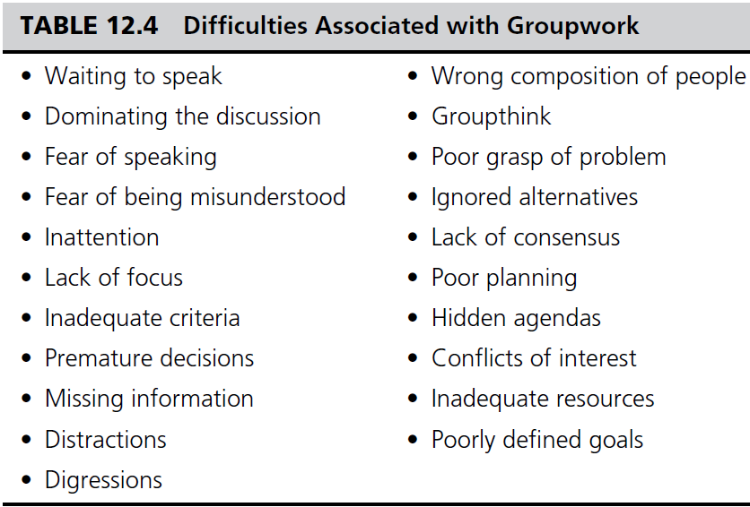
Groupwork

Slide 331
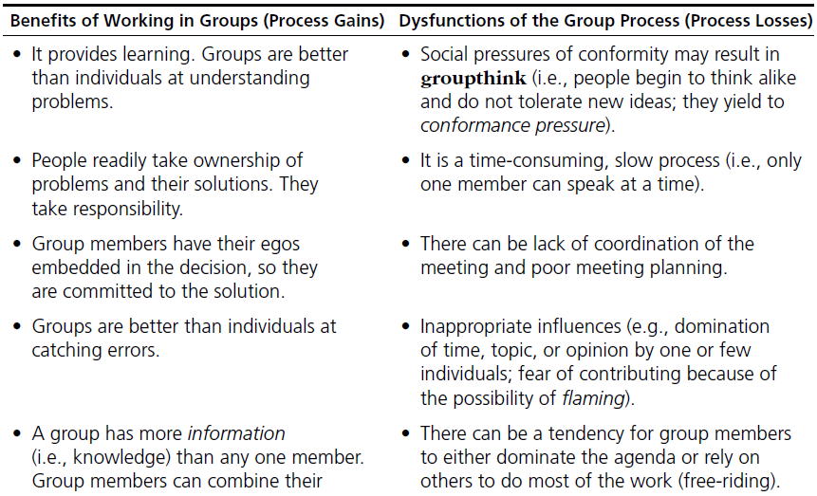
Groupwork –
Process Gains and Losses

Slide 332
Supporting Groupwork –
Group Support Systems
Goal: to support groupwork
Increase benefits / decrease losses
Based on traditional methods
  Nominal Group Technique
  “Individuals work alone to generate ideas which are pooled under guidance of a trained facilitator”
  Delphi Method
  “A structured process for collecting and distilling knowledge from a group of experts by means of questionnaires”
Electronic Meeting System (EMS)

Slide 333
Groupware
Lotus Notes / Domino Server
  Includes Learning Space
Netscape Collabra Server
Microsoft NetMeeting
Novell Groupwise
GroupSystems
TCBWorks
WebEx

Slide 334
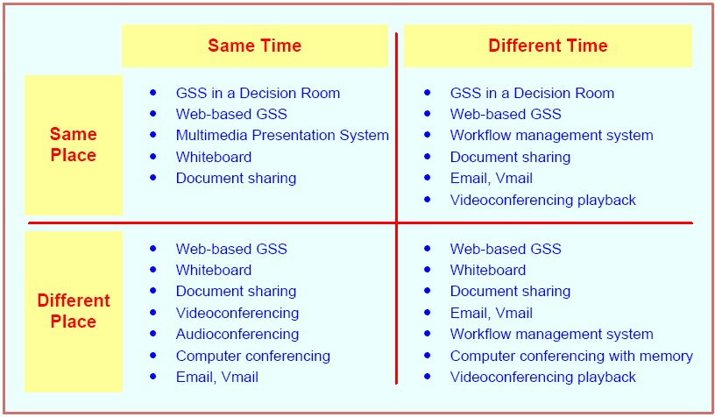
A Time/Place Communication Framework for Groupwork

Slide 335
Tools for Indirect Support of Decision Making
Groupware products provide a way for groups to share resources and opinions
Synchronous or Asynchronous
Examples
  dropbox.com
  drive.google.com
  office.microsoft.com
  …
See Table 12.5 for a list of examples

Slide 336
Group Decision Support Systems
It is an interactive computer-based system that facilitates the solution of semistructured or unstructured problems by a group of decision makers
Goal – support group decision making
A specially designed IS to enhance collaborative decision processes
It encourages generation of ideas, freedom of expression, and resolution of conflicts

Slide 337
GDSS – Pros and Cons
Gains:
Parallelism
Anonymity →
Triggering
Synergy
Structure
Record keeping
Loses:
Free-riding
Flaming

Slide 338
Facilities for GDSS
Decision room
Multiple-use facility
Web based

Slide 339
The Decision Room
12 to 30 networked personal computers
Usually recessed into the desktop
Server PC
Large-screen projection system
Breakout rooms
Need a trained facilitator for success

Slide 340
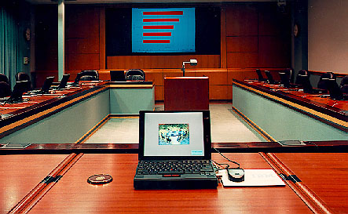
Cool Decision Rooms
IBM Corp.

Slide 341

Cooler Decision Rooms
US Air Force

Slide 342
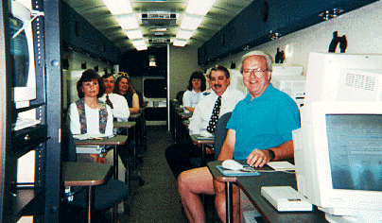
Mobile Decision Rooms
Murraysville School District Bus

Slide 343
On-Demand Decision Rooms

Slide 344
Very Few Organizations Use Decision Rooms
High Cost
Need for a Trained Facilitator
Requires Specific Software Support for Different Cooperative Tasks
Infrequent Use
Different Place / Different Time Needs
May Need More Than One

Slide 345
End of the Chapter
Questions, comments

Slide 346
Business Intelligence and Analytics: Systems for Decision Support
(10th Edition)
Chapter 13:
Big Data Analytics

Slide 347
Big Data -
Definition and Concepts
Big [volume] Data is not new!
Big Data means different things to people with different backgrounds and interests
Traditionally, “Big Data” = massive volumes of data
  E.g., volume of data at CERN, NASA, Google, …
Where does the Big Data come from?
  Everywhere! Web logs, RFID, GPS systems, sensor networks, social networks, Internet-based text documents, Internet search indexes, detail call records, astronomy, atmospheric science, biology, genomics, nuclear physics, biochemical experiments, medical records, scientific research, military surveillance, multimedia archives, …

Slide 348
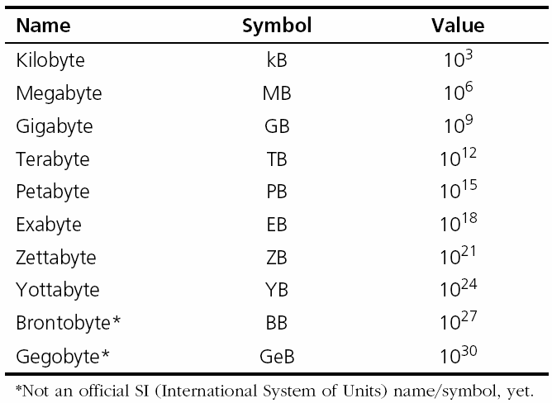
Technology Insights 6.1
The Data Size Is Getting Big, Bigger…
Hadron Collider - 1 PB/sec
Boeing jet - 20 TB/hr
Facebook - 500 TB/day.
YouTube – 1 TB/4 min.
The proposed Square Kilometer Array telescope (the world’s proposed biggest telescope) – 1 EB/day
Names for Big Data Sizes

Slide 349

Big Data -
Definition and Concepts
Big Data is a misnomer!
Big Data is more than just “big”
The Vs that define Big Data
  Volume
  Variety
  Velocity
  Veracity
  Variability
  Value
  …

Slide 350
A High-level Conceptual Architecture for Big Data Solutions
(by AsterData / Teradata)

Slide 351
Fundamentals of
Big Data Analytics
Big Data by itself, regardless of the size, type, or speed, is worthless
Big Data + “big” analytics = value
With the value proposition, Big Data also brought about big challenges
  Effectively and efficiently capturing, storing, and analyzing Big Data
  New breed of technologies needed (developed (or purchased or hired or outsourced …)

Slide 352
Big Data Considerations
You can’t process the amount of data that you want to because of the limitations of your current platform.
You can’t include new/contemporary data sources (e.g., social media, RFID, Sensory, Web, GPS, textual data) because it does not comply with the data schema.
You need to (or want to) integrate data as quickly as possible to be current on your analysis.
You want to work with a schema-on-demand data storage paradigm because the variety of data types.
The data is arriving so fast at your organization’s doorstep that your analytics platform cannot handle it.
…

Slide 353
Critical Success Factors for
Big Data Analytics
A clear business need (alignment with the vision and the strategy)
Strong, committed sponsorship (executive champion)
Alignment between the business and IT strategy
A fact-based decision-making culture
A strong data infrastructure
The right analytics tools
Right people with right skills

Slide 354
Enablers of Big Data Analytics
In-memory analytics
  Storing and processing the complete data set in RAM
In-database analytics
  Placing analytic procedures close to where data is stored
Grid computing & MPP
  Use of many machines and processors in parallel (MPP- massively parallel processing)
Appliances
  Combining hardware, software and storage in a single unit for performance and scalability

Slide 355
Challenges of Big Data Analytics
Data volume
  The ability to capture, store, and process the huge volume of data in a timely manner
Data integration
  The ability to combine data quickly/cost effectively
Processing capabilities
  The ability to process the data quickly, as it is captured (i.e., stream analytics)
Data governance (… security, privacy, access)
Skill availability (… data scientist)
Solution cost (ROI)

Slide 356
Business Problems Addressed by
Big Data Analytics
Process efficiency and cost reduction
Brand management
Revenue maximization, cross-selling/up-selling
Enhanced customer experience
Churn identification, customer recruiting
Improved customer service
Identifying new products and market opportunities
Risk management
Regulatory compliance
Enhanced security capabilities
…

Slide 357



Big Data Technologies
MapReduce …
Hadoop …
Hive
Pig
Hbase
Flume
Oozie
Ambari
Avro
Mahout, Sqoop, Hcatalog, ….

Slide 358
Big Data Technologies
- MapReduce
MapReduce distributes the processing of very large multi-structured data files across a large cluster of ordinary machines/processors
Goal - achieving high performance with “simple” computers
Developed and popularized by Google
Good at processing and analyzing large volumes of multi-structured data in a timely manner
Example tasks: indexing the Web for seearch, graph analysis, text analysis, machine learning, …

Slide 359
Big Data Technologies
- MapReduce
How does
MapReduce
work?

Slide 360

Big Data Technologies
- Hadoop
Hadoop is an open source framework for storing and analyzing massive amounts of distributed, unstructured data
Originally created by Doug Cutting at Yahoo!
Hadoop clusters run on inexpensive commodity hardware so projects can scale-out inexpensively
Hadoop is now part of Apache Software Foundation
Open source - hundreds of contributors continuously improve the core technology
MapReduce + Hadoop = Big Data core technology

Slide 361
Big Data Technologies
- Hadoop
How Does Hadoop Work?
  Access unstructured and semi-structured data (e.g., log files, social media feeds, other data sources)
  Break the data up into “parts,” which are then loaded into a file system made up of multiple nodes running on commodity hardware using HDFS
  Each “part” is replicated multiple times and loaded into the file system for replication and failsafe processing
  A node acts as the Facilitator and another as Job Tracker
  Jobs are distributed to the clients, and once completed the results are collected and aggregated using MapReduce

Slide 362
Big Data Technologies
- Hadoop
Hadoop Technical Components
  Hadoop Distributed File System (HDFS)
  Name Node (primary facilitator)
  Secondary Node (backup to Name Node)
  Job Tracker
  Slave Nodes (the grunts of any Hadoop cluster)
  Additionally, Hadoop ecosystem is made-up of a number of complementary sub-projects: NoSQL (Cassandra, Hbase), DW (Hive), …
    NoSQL = not only SQL

Slide 363
Big Data Technologies
Hadoop - Demystifying Facts
Hadoop consists of multiple products
Hadoop is open source but available from vendors, too
Hadoop is an ecosystem, not a single product
HDFS is a file system, not a DBMS
Hive resembles SQL but is not standard SQL
Hadoop and MapReduce are related but not the same
MapReduce provides control for analytics, not analytics
Hadoop is about data diversity, not just data volume.
Hadoop complements a DW; it’s rarely a replacement.
Hadoop enables many types of analytics, not just Web analytics.

Slide 364
Data Scientist
“The Sexiest Job of the 21st Century”
Thomas H. Davenport and D. J. Patil
Harvard Business Review, October 2012
Data Scientist = Big Data guru
  One with skills to investigate Big Data
Very high salaries, very high expectations
Where do Data Scientist come from?
  M.S./Ph.D. in MIS, CS, IE,… and/or Analytics
  There is not a specific degree program for DS!
  PE, PML, … DSP (Data Sceice Professional)

Slide 365
Skills That Define a Data Scientist

Slide 366

A Typical Job Post for Data Scientist

Slide 367
Big Data And Data Warehousing
What is the impact of Big Data on DW?
  Big Data and RDBMS do not go nicely together
  Will Hadoop replace data warehousing/RDBMS?
Use Cases for Hadoop
  Hadoop as the repository and refinery
  Hadoop as the active archive
Use Cases for Data Warehousing
  Data warehouse performance
  Integrating data that provides business value
  Interactive BI tools

Slide 368

Hadoop versus Data Warehouse
When to Use Which Platform

Slide 369
Coexistence of Hadoop and DW
Use Hadoop for storing and archiving multi-structured data
Use Hadoop for filtering, transforming, and/or consolidating multi-structured data
Use Hadoop to analyze large volumes of multi-structured data and publish the analytical results
Use a relational DBMS that provides MapReduce capabilities as an investigative computing platform
Use a front-end query tool to access and analyze data

Slide 370

Coexistence of Hadoop and DW
Source: Teradata

Slide 371
Big Data Vendors
Big Data vendor landscape is developing very rapidly
A representative list would include
  Cloudera - cloudera.com
  MapR – mapr.com
  Hortonworks - hortonworks.com
  Also, IBM (Netezza, InfoSphere), Oracle (Exadata, Exalogic), Microsoft, Amazon, Google, …
Software,
Hardware,
Service, …

Slide 372
Top 10 Big Data Vendors with Primary Focus on Hadoop

Slide 373
Big Data And Stream Analytics
Data-in-motion analytics and real-time data analytics
One of the Vs in Big Data = Velocity
Analytic process of extracting actionable information from continuously flowing/streaming data
Why Stream Analytics?
  It may not be feasible to store the data
  It may loose its value if not processed immediately
Stream Analytics Versus Perpetual Analytics
Critical Event Processing?

Slide 374
Stream Analytics Applications
e-Commerce
Telecommunication
Law Enforcement and Cyber Security
Power Industry
Financial Services
Health Services
Government

Slide 375
End of the Chapter
Questions, comments

Slide 376
Business Intelligence and Analytics: Systems for Decision Support
(10th Edition)
Chapter 14:
Business Analytics: Emerging Trends and Future Impacts

Slide 377
Location-Based Analytics
Geospatial Analytics
Geocoding
  Visual maps
  Postal codes
  Latitude & Longitude
Enables aggregate view of a large geographic area
Integrate “where” into customer view

Slide 378

Location-Based Analytics

Slide 379
Location-Based Analytics
Location-based databases
Geographic Information System (GIS)
  Used to capture, store, analyze, and manage the data linked to a location
  Combined with integrated sensor technologies and global positioning systems (GPS)
Location Intelligence (LI)?
  Interactive maps that further drill down to details about any location

Slide 380
Use of Location-Based Analytics
Retailers – location + demographic details combined with other transactional data can help …
  determine how sales vary by population level
  assess locational proximity to other competitors and their offerings
  assess the demand variations and efficiency of supply chain operations
  analyze customer needs and complaints
  better target different customer segments

Slide 381
Use of Location-Based Analytics
Global Intelligence
  U.S. Transportation Command (USTRANSCOM)
    track the information about the type of aircraft
    maintenance history
    complete list of crew
    equipment and supplies on the aircraft
    location of the aircraft
  → well-informed decisions for global operations
Overlaying weather and environmental data
Teradata, NAVTEQ, Tele Atlas …

Slide 382
Geospatial Analytics Examples
Sabre Airline Solutions’ application
  Traveler Security
  Geospatial-enabled dashboard
  Assess risks across global hotspots
  Interactive maps
    Find current travelers
    Respond quickly in the event of any travel disruption
Telecommunication companies
  Analysis of failed connections
  See the Multimedia Exercise, next

Slide 383
Real-Time Location Intelligence
Many devices are constantly sending out their location information
  Cars, airplanes, ships, mobile phones, cameras, navigation systems, …
    GPS, Wi-Fi, RFID, cell tower triangulation
Reality mining?
  Real-time location information = real-time insight
  Path Intelligence (pathintelligence.com)
    Footpath – movement patterns within a city or store
    How to use such movement information

Slide 384
Real-Time Location Intelligence
Targeting right customer based on their behavior over geographic locations
Example Radii app
  Collects information about the user’s favorite locations, habits, interests, spending patterns, …
  Radii uses the Gimbal Context Awareness SDK
  Combines time + place + duration + action + …
  Assigns Location Personality → Recommendation
  New members receive 10 “Radii” to spend
  Radii can be earned and spent on those locations
  For more info, search for radii app on the Internet

Slide 385
Real-Time Location Intelligence
Augmented reality
Cachetown - augmented reality-based game
  Encourage users to claim offers from select geographic locations
  User can start anywhere in a city and follow markers on the Cachetown app to reach a coupon, discount, or offer from a business
  User can point a phone’s camera toward the virtual item through the Cachetown app to claim it
  Claims → free good/discount/offer from a nearby business
  For more info, go to cachetown.com/press

Slide 386
Analytics Applications for Consumers
Explosive growth of the apps industry
  iOS, Android, Windows, Blackberry, Amazon, …
  Directly used by consumers (not businesses)
  Enabling consumers to become more efficient
  Interesting Examples
    CabSense – finding a taxi in New York City
      Rating of street corners; interactive maps, …
    ParkPGH – finding a parking spot
      Downtown Pittsburgh, Pennsylvania
      For a related example, see Application Case 14.3, next

Slide 387
Recommendation Engines
People rely on recommendations by others
  Success for retailer line Amazon.com
Recommender systems
  Web-based information filtering system that takes the inputs from users and then aggregates the inputs to provide recommendations for other users in their product or service selection choices
Data
  Structured → ratings/rankings
  Unstructured → textual comments

Slide 388
Recommendation Engines
Two main approaches for recommendation systems
  Collaborative filtering
    Based on previous users’ purchase/view/rating data
    Collectively deriving user ⬄ item profiling
    Use this knowledge for item recommendations
    Techniques include user-item rating matrix, kNN, correlation, …
    Disadvantage – requires huge amount of historic data
  Content filtering
    Based on specifications/characteristics of items (not just ratings)
    First, characteristics of an item are profiled, and then the content-based individual user profiles are built
    Recommendations are made if there are similarities found in the item characteristics
    Techniques include decision trees, ANN, Bayesian classifiers

Slide 389
The Web 2.0 Revolution and Online Social Networking
Web 2.0?
  Advanced Web - blogs, wikis, RSS, mashups, user-generated content, and social networks
  Objective – enhance creativity, information sharing, and collaboration
  Changing the Web from passive to active
    Consumer is the one that creates the content
  Redefining what is on the Web as well as how it works
  Companies are adopting and benefiting from it

Slide 390
Representative Characteristics of Web 2.0
Allows tapping into the collective intelligence of users
Data is made available in new or never-intended ways
Relies on user-generated/user-controlled content/data
Lightweight programming tools for wider access
The virtual elimination of software-upgrade cycles
Users can access applications entirely through a browser
An architecture of participation and digital democracy
A major emphasis is on social networks and computing
Strong support for information sharing and collaboration
Fosters rapid and continuous creation of new business models

Slide 391
Social Networking
Social networking gives people the power to share, making the world open/connected
  Facebook, LinkedIn, Google+, Orkut, …
  Wikipedia, YouTube, …
A social network is a place where people create their own space, or homepage, on which they write blogs (Web logs); post pictures, videos, or music; share ideas; and link to other Web locations they find interesting
Mobile social networking

Slide 392
Social Networks - Implications of Business and Enterprise
Enhancing marketing and sales in public social networks
Using Twitter to Get a Pulse of the Market
  Listening to the public for opinions/sentiments
  Product/service brand management
  Text mining, sentiment analysis
  How – built in-house or outsource
    reputation.com
Share content in a messaging ecosystem
  WhatsApp, Draw Something, SnapChat, …

Slide 393
Cloud Computing and BI
A style of computing in which dynamically scalable and often virtualized resources are provided over the Internet.
Users need not have knowledge of, experience in, or control over the technology infrastructures in the cloud that supports them.
Cloud computing = utility computing, application service provider grid computing, on-demand computing, software-as-a-service (SaaS), …
  Cloud = Internet
  Related “-as-a-services”: infrastructure-as-a-service (IaaS), platforms-as-a-service (PaaS)

Slide 394
Cloud Computing Example
Web-based email → cloud computing application
  Stores the data (e-mail messages)
  Stores the software (e-mail programs)
  Centralized hardware/software/infrastructure
  Centralized updates/upgrades
  Access from anywhere via a Web browser
  e.g., Gmail
Web-based general application = cloud application
  Google Docs, Google Spreadsheets, Google Drive,…
  Amazon.com’s Web Services

Slide 395
Cloud Computing Example
Cloud computing is used in
  e-commerce, BI, CRM, SCM, …
Business model
  Pay-per-use
  Subscribe/pay-as-you-go
Companies that offer cloud-computing services
  Google, Yahoo!, Salesforce.com
  IBM, Microsoft (Azure)
  Sun Microsystems/Oracle

Slide 396
Cloud Computing and BI
Cloud-based data warehouse
  1010data, LogiXML, Lucid Era
Cloud-based ERP+DW+BI
  SAP, Oracle
Elastra and Rightscale
Amazon.com and Go Grid
SaaS
DaaS
SaaS
DaaS
+ IaaS

Slide 397
Cloud Computing and
Service-Oriented Thinking
Service-oriented thinking is one of the fastest-growing paradigms today
Toward building agile data, information, and analytics capabilities as services
Service orientation + DSS/BI
Component-based service orientation fosters
  Reusability, Substitutability, Extensibility, Scalability, Customizability, Reliability, Low Cost of Ownership, Economy of Scale,…

Slide 398

Service-Oriented DSS/BI

Slide 399
Major Components of
Service-Oriented DSS/BI
Data-as-a-Service (DaaS)
  Accessing data “where it lives”
  Enriching data quality with centralization
  Better MDM, CDI
  Access the data via open standards such as SQL, XQuery, and XML
  NoSQL type data storage and processing
    Amazon’s SimpleDB
    Google’s BigTable

Slide 400
Major Components of
Service-Oriented DSS/BI
Information-as-a-Service (IaaS)
  “Information on Demand”
  Goal is to make information available quickly to people, processes, and applications across the business (agility)
  Provides a “single version of the truth,” make it available 24/7, and by doing so, reduce proliferating redundant data and the time it takes to build and deploy new information services
  SOA, flexible data integration, MDM, …

Slide 401
Major Components of
Service-Oriented DSS/BI
Analytics-as-a-Service (AaaS)
  “Agile Analytics”
  AaaS in the cloud has economies of scale, better scalability, and higher cost savings
  Data/Text Mining + Big Data → Cloud Computing
    Storage and access to Big Data
    Massively Parallel Processing
    In-memory processing
    In-database processing
    Resource polling, scaling, cost and time saving, …

Slide 402
Impacts of Analytics in Organizations: An Overview
New Organizational Units
  Analytics departments
    Chief Analytics Officer, Chief Knowledge Officer
  Restructuring Business Processes and Virtual Teams
    Reengineering and BPR
  Job Satisfaction
  Job Stress and Anxiety
  Impact on Managers’ Activities/Performance

Slide 403
Issues of Legality, Privacy, and Ethics
Legal issues to consider
  What is the value of an expert opinion in court when the expertise is encoded in a computer?
  Who is liable for wrong advice (or information) provided by an intelligent application?
  What happens if a manager enters an incorrect judgment value into an analytic application?
  Who owns the knowledge in a knowledge base?
  Can management force experts to contribute their expertise?

Slide 404
Issues of Legality, Privacy, and Ethics
Privacy
  “the right to be left alone and the right to be free from unreasonable personal intrusions”
  Collecting Information About Individuals
    How much is too much?
  Mobile User Privacy
    Location-based analysis/profiling
  Homeland Security and Individual Privacy
  Recent Issues in Privacy and Analytics
    “What They Know” about you (wsj.com/wtk)
    Rapleaf (rapleaf.com), X + 1 (xplusone.com), Bluecava (bluecava.com), reputation.com, sociometric.com...

Slide 405
Issues of Legality, Privacy, and Ethics
Ethics in Decision Making and Support
  Electronic surveillance
  Software piracy
  Invasion of individuals’ privacy
  Use of proprietary databases
  Use of knowledge and expertise
  Accessibility for workers with disabilities
  Accuracy of data, information, and knowledge
  Protection of the rights of users
  Accessibility to information
  Personal use of corporate computing resources
  … more in the book

Slide 406
An Overview of
The Analytics Ecosystem
Analytics Industry Clusters
Data Infrastructure Data Warehouse Providers
Middleware/BI Platform Industry
Data Aggregators/Distributors
Analytics-Focused Software Developers
Application Developers or System Integrators
Analytics User Organizations
Analytics Industry Analysts and Influencers
Academic Providers and Certification Agencies

Slide 407

Analytics Ecosystem

Slide 408

Analytics Ecosystem - Titles of Analytics Program Graduates
Masters Degrees
UG Degrees
Certificate Programs
  …
Data Scientist
  …
Decision Science
Marketing Analytics
Management Science
  …

Slide 409
End of the Chapter
Questions, comments

